Slide 1
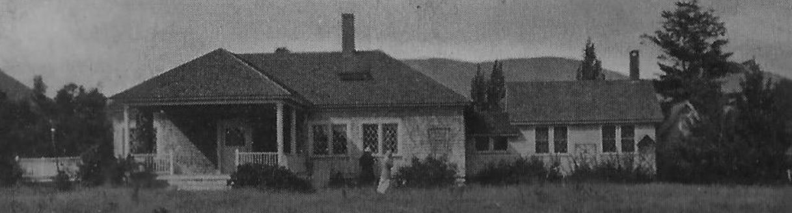
AMC Cold River Camp Lodge Project Update
Summer 2019
version 1.0 2019-06-22
Notes:
This Lodge Project Update presentation is structured so that all questions will be taken at the end.
This allows you the hear and follow the full rationale and logic behind the recommendations. So, please hold your questions until the end.

Slide 2
AMC Cold River Camp Lodge Project Update Agenda
Project Recap of year since Summer 2018
Who? Committee Members and Participants
Why? Main Drivers and Benefits of Project
How? Assessment Principles: Functional, Historic, Climatic Design, Code
Where? Direction Alternatives: South, North, West, East Recommendation with Rationale
What? Scope Alternatives: Minimum, Intermediate, Expanded Recommendation with Rationale
When? Timeline and Next Steps
Questions
Notes:
I will review the Lodge Project in terms of Who? Why? How? Where? What? And When? So, sit back, relax, and here we go...

Slide 3
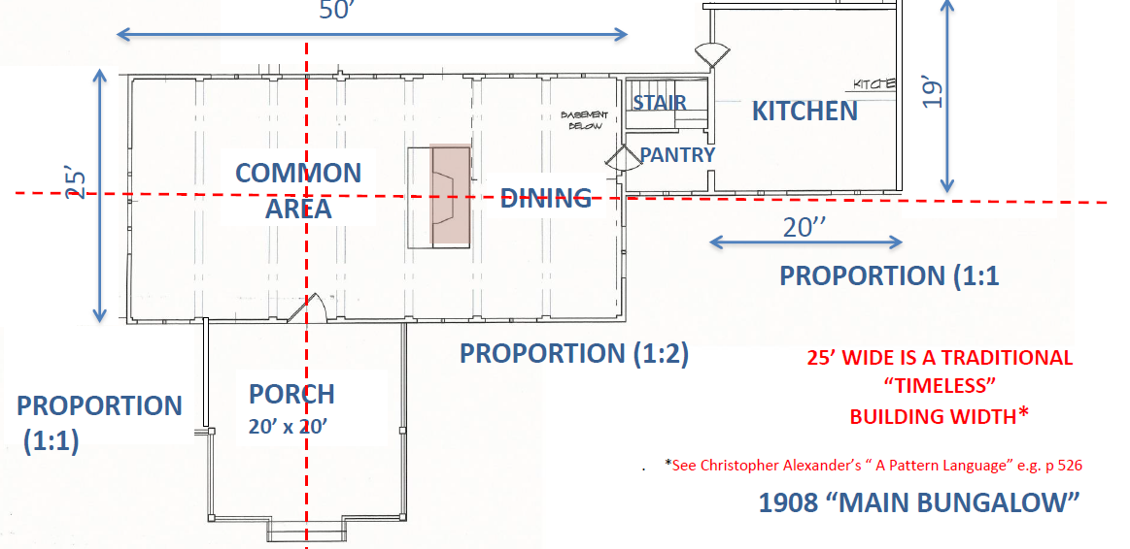
History of The Lodge
1908 - Lodge was built.
1919 - AMC acquired Camp. The Lodge was one of the original 6 buildings.
Notes:
--Despite many changes at Cold River Camp over the past 100 years including new cabins and other structures, and many repairs and replacements, the Camp retains a familiar and unchanging feel for many.
--This is due to an active policy to make sure changes fit in well with the historic nature of the facility, which has been adopted by Camp Committees over the decades, and is applied to this project.
--Needed changes and improvements are made so that they fit in well. One could argue that this policy has significantly helped the Camp prosper over the past 100 years. We now look to the next 100 years.
--Here is the floor plan of the original 1908 Lodge.

Slide 4
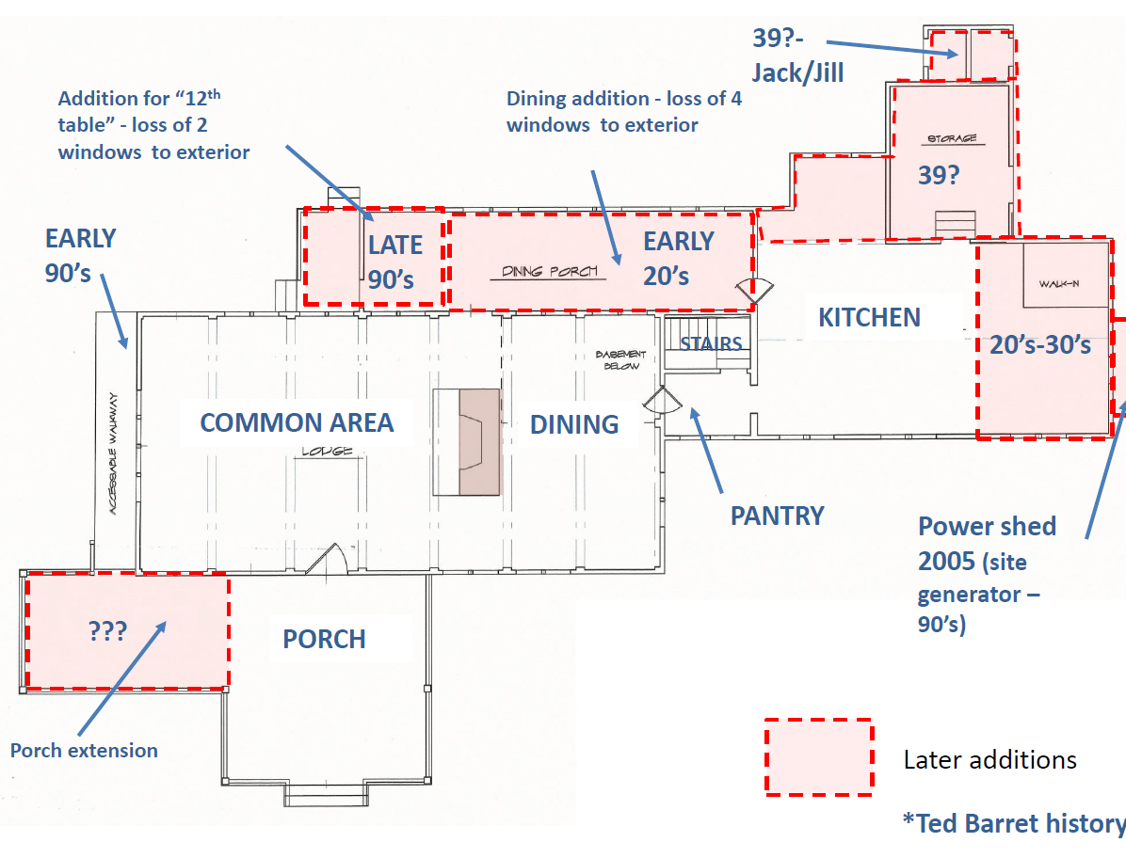
History of The Lodge
1920-30’s - Kitchen was extended east.
1920’s - Dining porch was added.
1983 - Kitchen major renovation
1990’s Dining porch extended.
.
Notes:
As you can see, the Lodge has changed and been added to over the years, especially with expansions to the north and east starting in 1920s and extending into the late 90s.
Here is a quick view of the history in a floor plan.

Slide 5
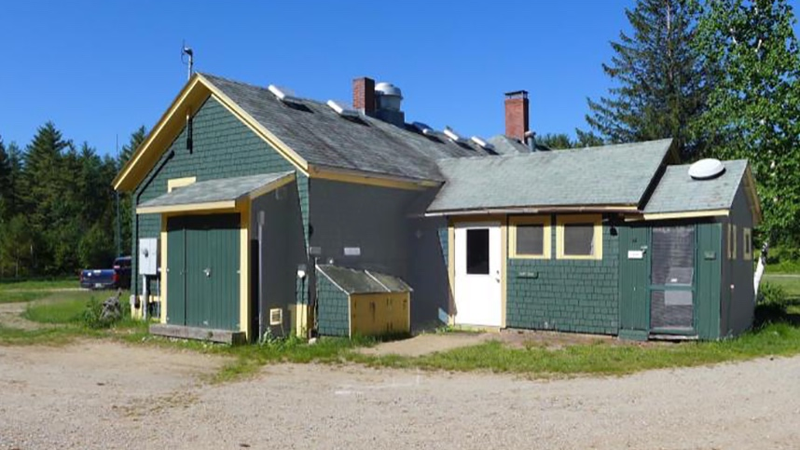
Tonight, we will take a journey starting here...
Notes:
In 2018, knowing major repairs of dining porch were needed, Gary Munson established the Lodge Planning Committee. Its mandate is to think broadly about the current Lodge conditions, and make recommendations of possible improvements, focusing mainly on the kitchen and dining areas.
Tonight, we will take a journey starting here….

Slide 6
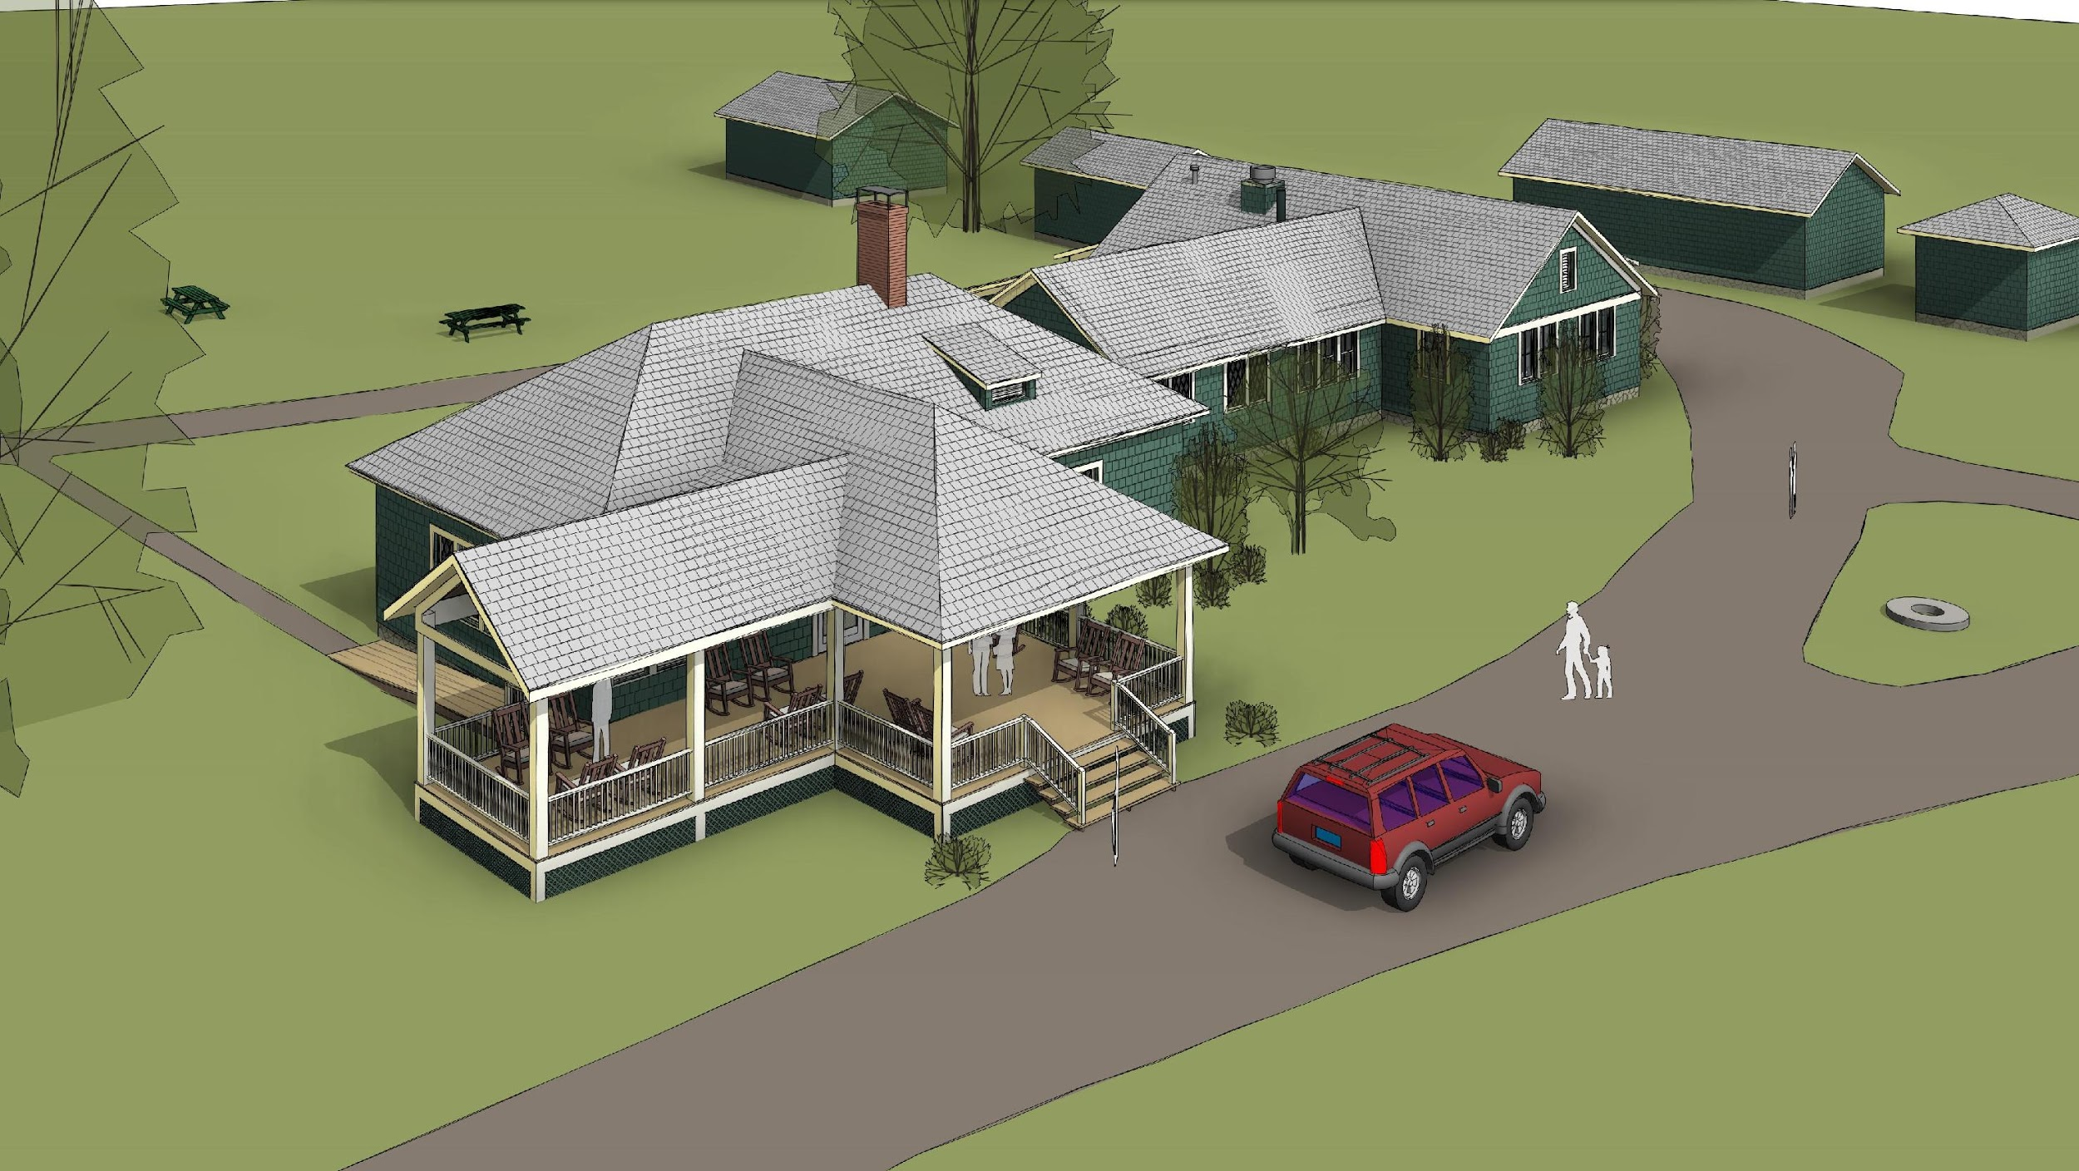
...that will end here.
Notes:
That will end here…
This is an aerial shot to give you a sense of the entire structure of the proposal we will discuss tonight, and how it fits in.
After we review the process used over the past year or more to get to this proposal, we will focus more intensively on the proposal and what the exterior and interior of the building will look like.

Slide 7
AMC CRC Lodge Project Who?
Notes:
Participants in the Lodge Project can be found in the next two slides.
Please note: Based on a rough back of the envelope calculation, this group combined has spent well over 700 hours in conferences calls, one on one discussions, and background work over the past year to develop the proposal we will review today.

Slide 8
Who? Lodge Planning Project Participants
Extensive plus diverse Cold River Camp and professional experience
Lodge Planning Project Committee Members (2018-19)
Gary Munson Chair CRC Committee, various other volunteer roles
John Dean Vice Chair CRC Committee, former Chair of AMC Volunteer-led Camps and Cabins
(VCC), and former Chair of CRC Committee
Mark Winkler Former Chair CRC Committee, former Camp Manager, various other volunteer roles
Jim Weston Former Chair CRC Committee, former Chair of VCCs, various other volunteer roles
Amy Damon Grover Former Chair CRC Committee and various other volunteer roles
Jan Irvin Long-time CRC Guest, Professional Architect and Senior Associate at Perfido,
Weiskopf, Wagstaff, & Goettel (PWWG)
Emma Crane CRC Committee member and various other volunteer roles
Garry Crane Long-time CRC Guest, various other volunteer roles
Roberta Kaufman Long-time CRC Guest, various other volunteer roles
Cheryl Poirier Former CRC Committee member, various other volunteer roles
Evan Doucett Long-time guest, Past Camp crew member
Frank Mastro CRC Facilities Manager, former Chair CRC Committee
Nancy Hartle CRC Committee member, various other volunteer roles
Notes:
Members include: current and former Camp Committee Chairs and Camp Committee members, long time guests most of whom have served in various CRC volunteer roles, the CRC Committee Facilities Manager, and a long time guest who is also a professional architect.
These individuals have a deep understand of the history of the Camp and how it operates. In addition, they represent perspectives across various weeks during the regular summer season and Extension.

Slide 9
Who? Lodge Planning Project Participants 2
Extensive plus diverse Cold River Camp and professional experience
Extensive input received from the following people at various times over past year
Bill Waste Former Camp Manager of CRC, and Camp Opening Weekend Coordinator
Laurie Barr Former Camp Manager of CRC
Zachary Porter Former Camp Cook, Off-season Event Cook and Food Service Coordinator
Nancy Grant Appalachian Mountain Club Director of Volunteer-led Camps and Cabins
Gail Roberts Camp Events Manager, other volunteer roles, and long-time guest
Anne Whitney Professional Architect, Portsmouth, NH
CR Camp Community Letters, emails 2018 Season feedback, phone calls, etc.,
Design Plan and Design Team
Design by PWWG, a Pittsburgh based architectural firm (Est. 1975), with extensive experience in historical structures. Principal-in-charge: Lisa Carver, AIA, LEED AP.
Kevin Wagstaff, AIA, LEED AP;
Marc Ford, RA, Associate;
Jan Lyle Irvin, AIA, LEED AP Senior Associate.
Kevin, Marc, and Jan each have hiked and stayed at AMC facilities in the White Mountains.
Notes:
Input was received from former Camp Managers, Camp Cook, and others CRC volunteers, and the AMC’s Director of Volunteer-led Camps and Cabins, and an architect.
Extensive input came from various people associated with Camp, and from significant feedback from the Camp Community.
A formal design plan, with a great deal of input from the Lodge Planning Committee, was completed by PWWG, a Pittsburg-based architectural firm that specializes in historical structures. Jan Irvin, a long-time Planning Committee member, temporarily stepped off of the CRC Lodge Planning Committee while working on the PWWG design plan in April through mid-June. We will look much more closely at this design plan soon.

Slide 10
AMC CRC Lodge Project Why?
Notes:
What are the main drivers of the project?

Slide 11
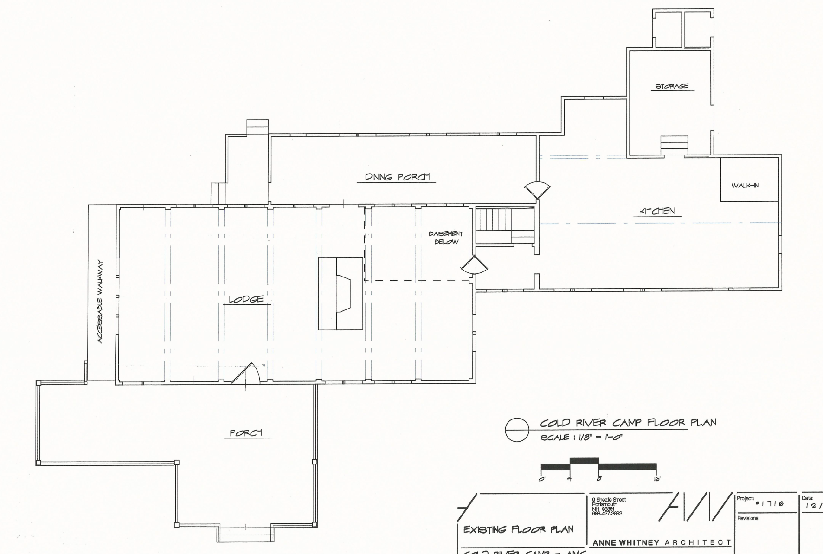
Why? Main Drivers and Benefits of CRC Lodge Project
Provide needed facility improvements in function, climatic performance and comfort including...
EXISTING LODGE
Notes:
Here is a rough floor plan of the various portions of the Lodge that we will be focusing on during this presentation.
The Lodge Project will provide significant benefits for the Camp. These include: …. Needed facility improvements in function, climatic performance, and comfort

Slide 12
Why? Main Drivers and Benefits of CRC Lodge Project
Modernize Kitchen to increase operating efficiency and enhance working environment
EXISTING LODGE
Notes:
The Lodge Project will provide significant benefits for the Camp. These include: 1. A modernized kitchen that will operate more efficiently, and create an improved working environment

Slide 13
Why? Main Drivers and Benefits of CRC Lodge Project
Improve guest bathroom availability and accessibility (ADA compliant)
Modernize Kitchen to increase operating efficiency and enhance working environment
EXISTING LODGE
Notes:
The Lodge Project will provide significant benefits for the Camp. These include: 2. Provide ADA compliant bathrooms and accessibility;

Slide 14
Why? Main Drivers and Benefits of CRC Lodge Project
Address required structural repairs of dining porch
Improve guest bathroom availability and accessibility (ADA compliant)
Modernize Kitchen to increase operating efficiency and enhance working environment
EXISTING LODGE
Notes:
The Lodge Project will provide significant benefits for the Camp. These include: 3. Fix required structural building issues;

Slide 15
Why? Main Drivers and Benefits of CRC Lodge Project
Address required structural repairs of dining porch
Improve guest bathroom availability and accessibility (ADA compliant)
Add dining room space (ADA seating, wheelchair access, more seating room)
Modernize Kitchen to increase operating efficiency and enhance working environment
EXISTING LODGE
Notes:
The Lodge Project will provide significant benefits for the Camp. These include: 4. Add dining space for greater ease of entry and exit, ADA seating, and wheelchair access;

Slide 16
Why? Main Drivers and Benefits of CRC Lodge Project
Address required structural repairs of dining porch
Improve guest bathroom availability and accessibility (ADA compliant)
Add dining room space (ADA seating, wheelchair access, more seating room)
Add living room social space
Modernize Kitchen to increase operating efficiency and enhance working environment
EXISTING LODGE
Notes:
The Lodge Project will provide significant benefits for the Camp. These include: 5. Added social area space;

Slide 17
Why? Main Drivers and Benefits of CRC Lodge Project
Integrate Solar energy as a means of reducing carbon footprint
Address required structural repairs of dining porch
Improve guest bathroom availability and accessibility (ADA compliant)
Add dining room space (ADA seating, wheelchair access, more seating room)
Add living room social space
Modernize Kitchen to increase operating efficiency and enhance working environment
EXISTING LODGE
Notes:
The Lodge Project will provide significant benefits for the Camp. These include: 6. Integrate solar energy to reduce carbon footprint

Slide 18
Why? Main Drivers and Benefits of CRC Lodge Project
Integrate Solar energy as a means of reducing carbon footprint
Address required structural repairs of dining porch
Improve guest bathroom availability and accessibility (ADA compliant)
Add dining room space (ADA seating, wheelchair access, more seating room)
Provide all needed facility improvements while balancing:
Camp History, Experience & Aesthetics
Greater AMC Mission
Building codes
Diversity of uses
Financial considerations
Add living room social space
P
Modernize Kitchen to increase operating efficiency and enhance working environment
EXISTING LODGE
Notes:
We evaluated improvements while balancing Camp history, experiences and Aesthetics, the greater AMC mission, building codes, diversity of uses and financial consideration. More later...

Slide 19
AMC CRC Lodge Project How?
Notes:
As the Planning Committee considered potential design options, it took a disciplined approach.

Slide 20
How? Assessment Principles
The Lodge Project Committee used design principles along several dimensions to assess and compare the existing lodge with all the alternative designs reviewed.
These dimensions included:
Functional & Operational
Historical & Aesthetics
Climatic Design
Sustainability
Accessibility
Code Conformity
Long life, loose fit flexibility.
Notes:
We applied design principles along several dimensions to our evaluate all potential new designs. The next set of slides reviews the dimensions considered.

Slide 21
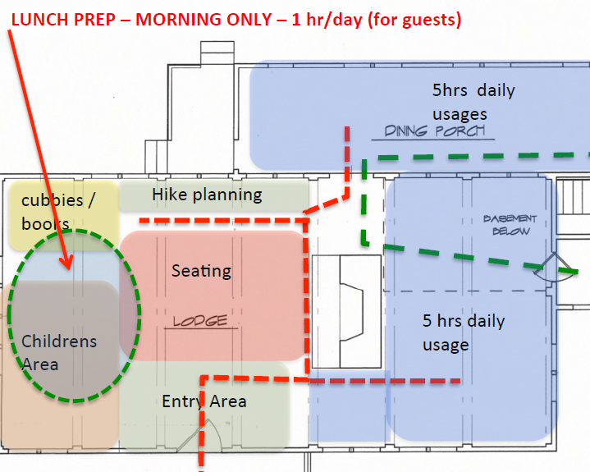
How? Assessment Principles - Functional.
Assessment of functional and operational space for the existing facility and for each alternative:
Use of space throughout day
Kitchen/Dining relationship
Crew workflows
Guest arrival sequence
Reduce crowding
Promote flexibility of: “long life, loose fit.”
crew flow
guest flow
Notes:
The functional aspects considered focused on how the facility functions from the guest and staff point of view. We took a long term view trying to look out into the future needs of the Camp.

Slide 22
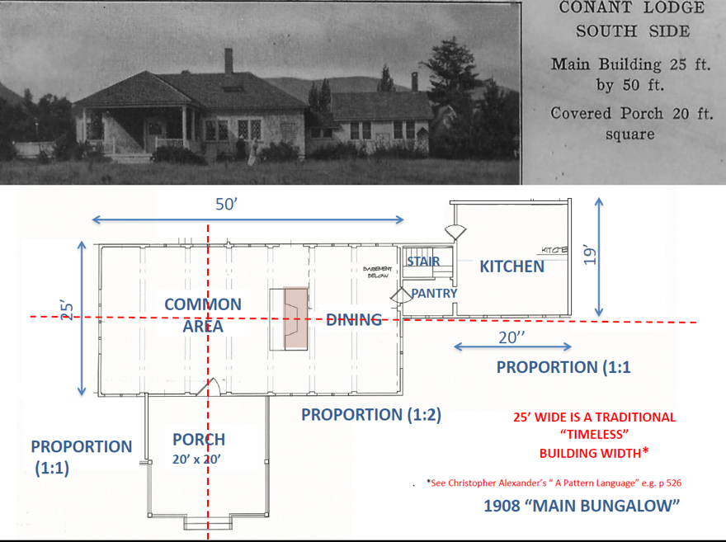
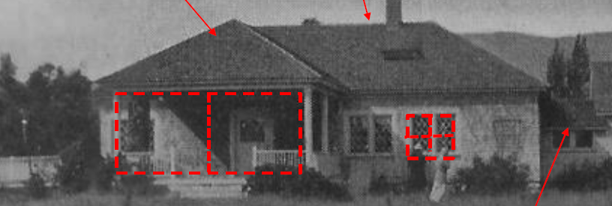
How? Assessment Principles - Historical/ Aesthetics.
Used National Park Service Standards for Rehabilitation used for guidance.
Recognition Conant Lodge as one of the earliest AMC structures. Respect existing view.
Preserving aesthetics, form and scale of “shingle style bungalow” including interior flow.
Notes:
We were guided by the National Park Services Standards for Rehabilitation as way of making sure we focused on maintaining a good historical view of the project.

Slide 23
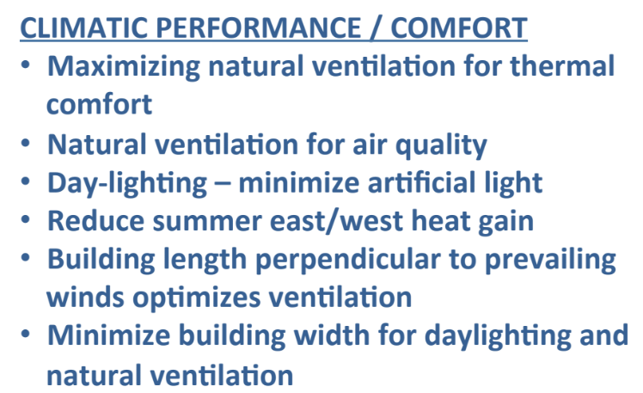
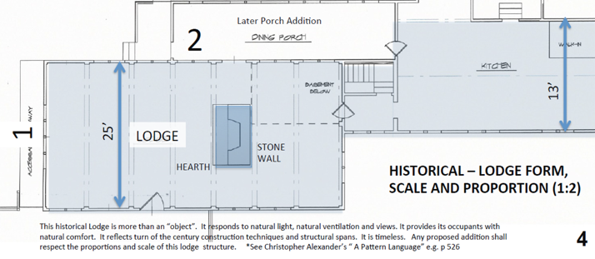
How? Assessment Principles - .Climatic Design.
Climatic Design:
25’ building width means furthest point from window (i.e., light, fresh air, views) is 12’ to 13’.
An East-West building orientation is optimal. It minimizes summer heat gain.
A narrow building footprint enhances daylight exposure (and views) from more than one direction.
Notes:
We incorporated climatic design in our planning to maximize natural ventilation and minimize the use of artificial light.

Slide 24
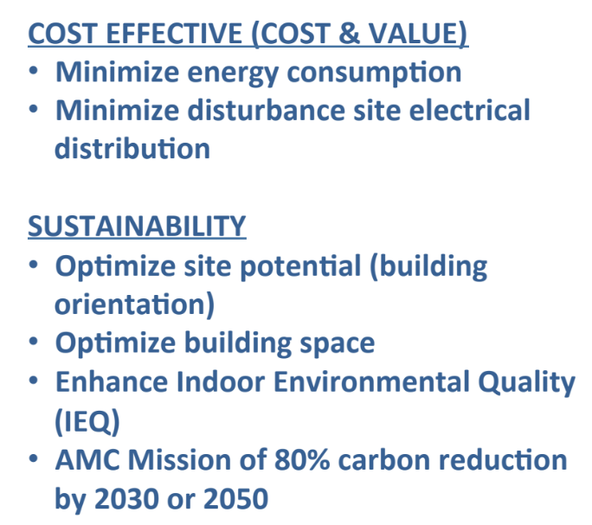

How? Assessment Principles - Sustainability.
Energy Resource Consumption:
Photovoltaics as optimal energy conservation strategy.
Living Building Challenge accountable to metrics but not project registration
Notes:
We considered sustainability in the plans to minimize energy consumption.

Slide 25
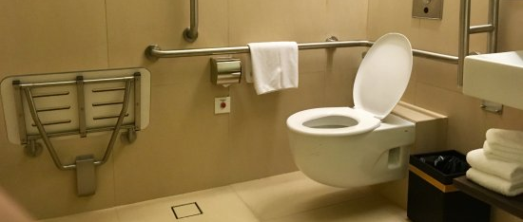
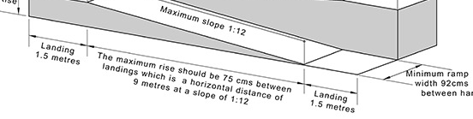
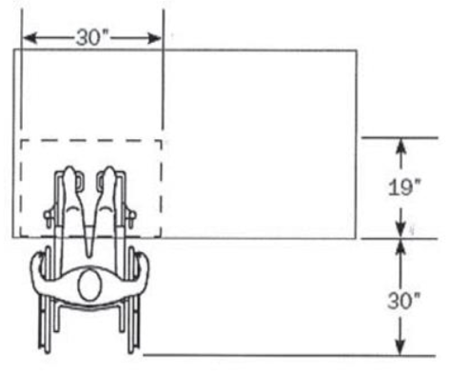
How? Assessment Principles - Accessibility.
Enhance experience and welcome for all those with disabilities including mobility, sight, hearing impaired, parents with newborns, seniors, etc.
“Where dining surfaces are provided ...at least 5% of the seating spaces shall comply…” and “...shall be dispersed…” (i.e., 72 x 5% = 3.6, or 4)
Notes:
Accessibility was a key feature in our planning evaluation.

Slide 26
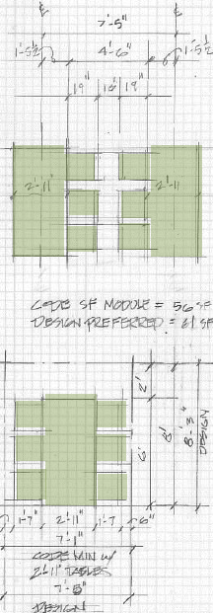
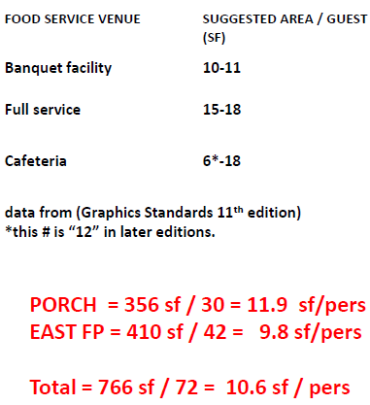
How? Assessment Principles - .Code Conformity.
While CRC is compliant with current code, with project increase code conformity, where feasible, in comparison to the 2018 code.
Notes:
We reviewed building codes and their implications.

Slide 27
How? Assessment Principles applied to each Option
Assessment Matrix | Existing Lodge | Option 1 | Option 2 | Option 3
Functional/ Operational | baseline
Historic/ Aesthetics | baseline
Climatic Design | baseline
Sustainability | baseline
Accessibility | baseline
Code Conformity | baseline
Financials | baseline
Each option, including existing lodge, was evaluated using all Assessment Principles.
Notes:
We applied these assessment principles to evaluate all options.

Slide 28
AMC CRC Lodge Project Where? Direction?
Notes:
The next set of slides will give you a sense of how the process was applied to some of the more promising options as well as our conclusions.

Slide 29
The Evaluation of Alternatives including
Where? Direction? South, North, West, or East?
What? Scope? Minimum, Intermediate, or Expanded?
We will first review the Direction and then Scope ➤ ➤ ➤
Many alternative plans from many sources were proposed by the community.
Most plans were evaluated by committee using Assessment Principles.
Proposals were clustered by an addition’s direction from main lodge (N,S,E,W).
We will first recap the plan evaluations around the four points of compass
To address needs of Camp, we also looked different project scopes: Minimum, Intermediate, and Expanded and compared the costs/benefits for each option.
Notes:
The Planning Committee considered a variety of ways to accomplish our goals beginning last summer. We initially worked closely with Anne Whitney, a NH based architect with experience in historical structures. Over many months we evaluated a variety of possible designs that involved some expansion northward and westward. We did not consider a southward expansion as it result in too big a change in the historical structure and would not work operationally.
We evaluated the plans based on four main design criteria: 1. Functional/operational; 2. Aesthetics/historical; 3. Climatic performance/comfort; 4. Sustainability. Each member of the Planning Committee scored each design and we compared each design’s scores with the existing Lodge based using the four criteria -- our goal was to eliminate designs that we believed were inferior to the existing Lodge, leaving us to concentrate more closely on those that provided for overall improvement. The Planning Committee’s goal was to develop a proposed that would result in a significant improvement for for the Camp. A plan offering only a slight improvement was not considered adequate enough to pursue further.
Jan Irvin, who is a Lodge Planning Committee member and architect presented a broad outline of an East Design that might meet many of the needs identified by the Committee after this exhaustive analysis. After initial discussions, it was decided that more detailed designs would be needed to move forward.
The next set of slides are meant for illustrative purposes only, and show you the floor plans of the existing Lodge, and a few of the plans considered. This is meant to give you a flavor of the many months of extensive analysis that the Planning Committee completed regarding the north and west designs.

Slide 30
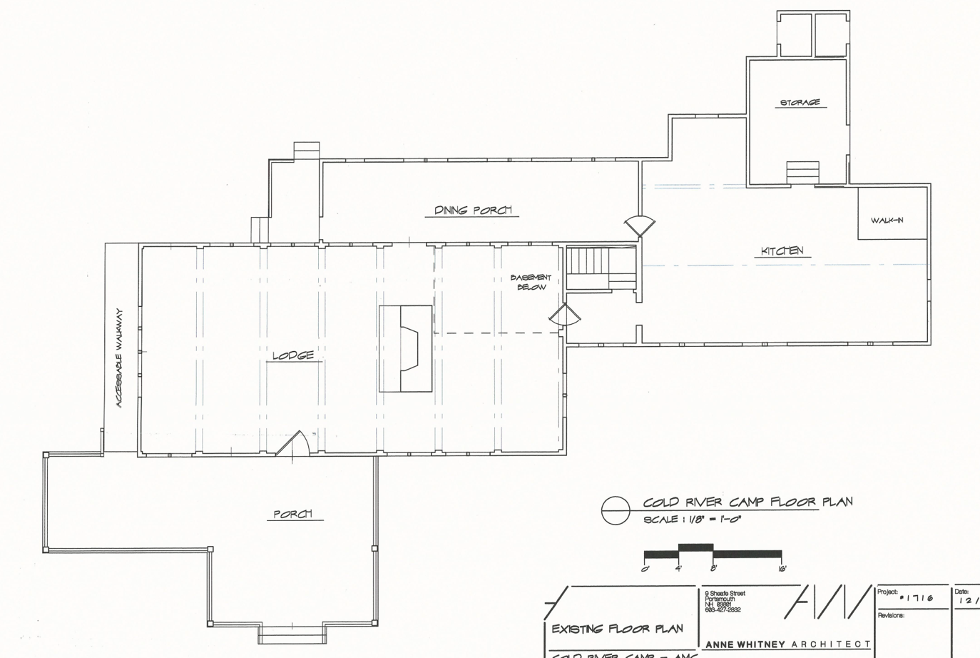
EXISTING LODGE
Dark outline reference box represents original Conant Lodge
Notes:
This is a floor plan of the entire Lodge complex: dining, kitchen, and social areas. The dark outline box represents the original 1908 Lodge.

Slide 31
EXISTING LODGE
North
Pink represents dining area for each plan
West
East
Yellow represents kitchen area for each plan
South
Notes:
We evaluated plans that involved expanding in all four directions, North, South, East, and West.
We highlight in PINK the dining area and in YELLOW the kitchen in this and the next few slides.
PLEASE NOTE: The next few slides show some examples, where we point out only a few of the positives and negatives. The Lodge Planning Committee did a much more exhaustive analysis on each concept to reach its conclusions.

Slide 32
South Expansion
Key features: Expand kitchen, dining, and/or living footprint south of existing line.
Key result: Significant change to historic front of Camp. Space constraint due to driveway. Greater distance to septic. Not considered.
South
Notes:
Expanding southward was reviewed but not pursued especially because of historical considerations.

Slide 33
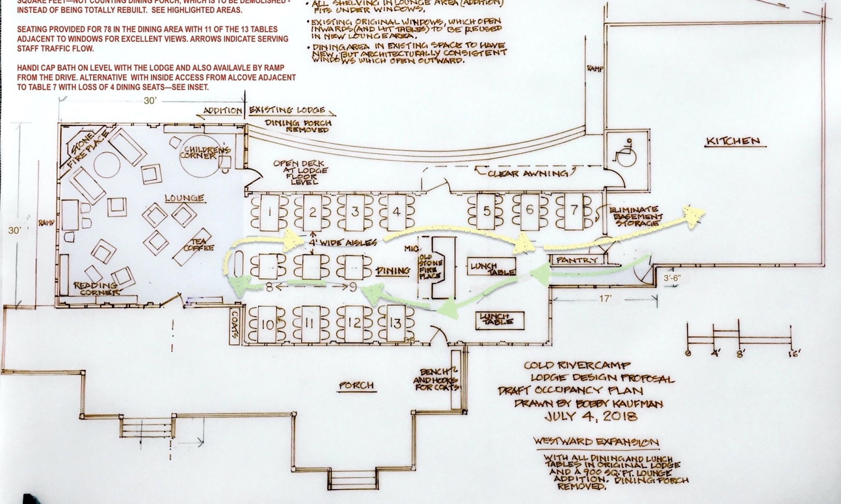
West Concept (one example)
Key features: Expand Lodge westward and slight northward. Move dining area to front of fireplace.
West
Key result: Low ratings for guest flow, dining experience, historical feel, and crew access.
Notes:
The West Alt 1 Concept moves most of the dining into the area in front of the fireplace in the Lodge. The loss of the social area in front of the fireplace led us to an expansion to the west and north.
This plan scored low especially in : 1. Guest flow, 2. Dining experience, 3. Maintaining the historical look and feel of the Lodge, and 4. Crew access to dining tables

Slide 34
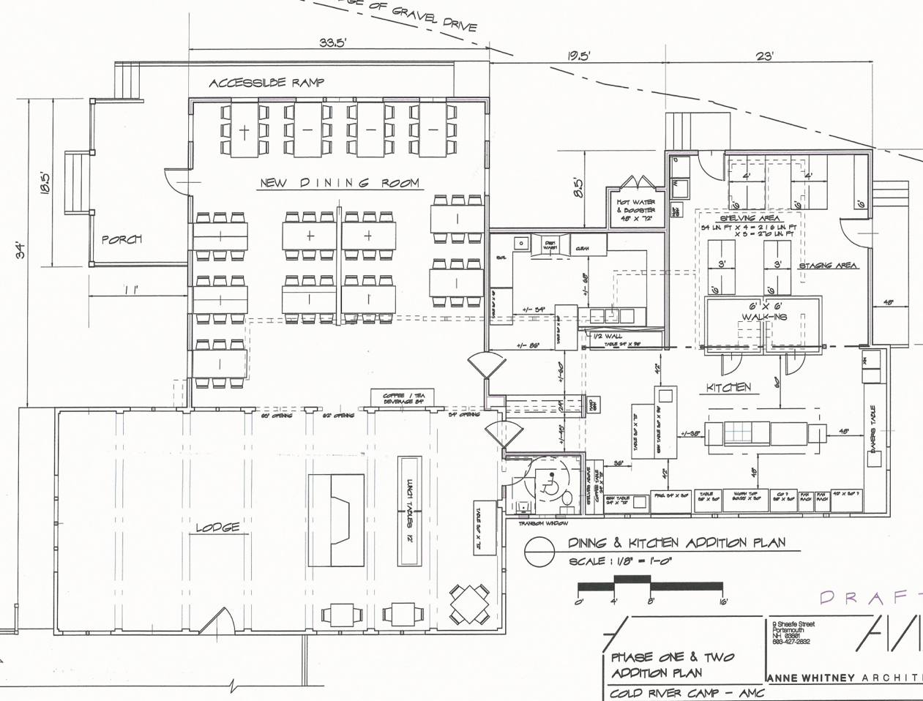
North Concept (one example)
North
Key features: Northern Expansion of the dining porch
Key result: Reasonable guest flow, but poor sense of historical scale. Significant light and ventilation issues.
Of all concepts, this one had the most contention on committee.
Notes:
The North concept expands the dining porch northward.
There was a marginal improvement versus the existing Lodge in: 1. Guest flow and dining experience, 2. Ease of access for the crew and guests, 3. Look and feel of the dining experience,
But 1. Poor sense of historical scale, 2. May have light and ventilation issues

Slide 35
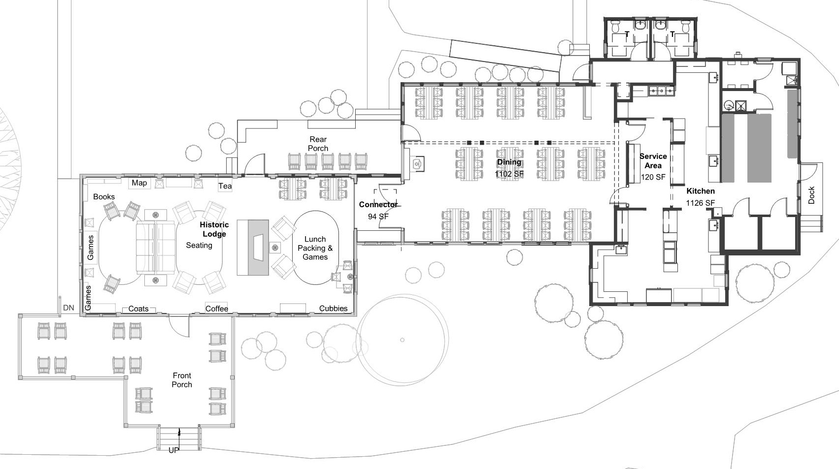
East Concept
Key features: Restores original Lodge by moving dining area into kitchen building and building new kitchen in the east
East
Key result: Modernized Kitchen, structural issues fixed, improves accessibility, adds dining space, adds social space, and integrates solar.
Of all concepts, this one had the most agreement on committee.
Notes:
East Concept restores the original Lodge by moving dining area into historic kitchen building and extending the structure eastward to create a new kitchen. It was the most promising concept. We then hired of an architectural firm to explore further.
This plan allows us to 1. Modernize Kitchen to gain efficiency and enhance working environment, 2. Fix Required structural repairs (i.e., dining porch), 3. Improve guest bathroom availability and accessibility (ADA compliant), 4. Add dining room space (ADA seating, wheelchair access, greater seating room), 5. Add living room social space, 6. Integrate Solar energy as a means of reducing carbon footprint
…all the while balancing:
Camp History and experience and aesthetics, 2. Greater AMC Mission, 3. Diversity of uses 4. Financial

Slide 36
Where? Direction Recap and Recommendation
Where? | South | West | North | East
Functional Analysis | Limited space for building. Driveway. | Disruptive workflow. | OK workflow. Has more space. | Good work flow. Has more space.
Historical & Aesthetics | Destroys historic and iconic view. | Disrupts historic exterior & interior. | Disrupts historic exterior & interior. | Historic Lodge restoration.
Climatic Design & Sustainability | North/South axis not good climatic design. | East/West axis good climatic design. | North/South axis not good climatic design. | East/West axis good climatic design.
Summary | Destructive | Disruptive | Divisive | Desirable
Notes:
This slides summarizes our findings and why we decided to move forward with exploring the east option in more detail. The East plan has clear advantages that we will explore in more detail later.

Slide 37
AMC CRC Lodge Project What? Scope?
Notes:
As part of the process, the Planning Committee also considered three levels of Lodge improvements and the implications of each. They are Minimum, Intermediate, and Expanded.

Slide 38
What? Alternatives of Scope - Kitchen
Effort by Area | Minimum | Intermediate | Expanded
Kitchen | Keep same footprint. Replace/repair equipment. | Keep & expand footprint. Replace/repair equipment. Rebuild shed, raise floor. | Build new kitchen building Replace/repair equipment. Add grill within kitchen.
Notes:
You can view the impact of each level on the Kitchen.

Slide 39
What? Alternatives of Scope - Dining Room
Effort by Area | Minimum | Intermediate | Expanded
Kitchen | Keep same footprint. Replace/repair equipment. | Keep & expand footprint. Replace/repair equipment. Rebuild shed, raise floor. | Build new kitchen building Replace/repair equipment. Add grill within kitchen.
Dining Room | Keep existing. Repair porch | Keep and expand existing Rebuild and expand porch | Rebuild new Dining Room by repurposing old kitchen
Notes:
And on the Dining room.

Slide 40
What? Alternatives of Scope - Accessibility
Effort by Area | Minimum | Intermediate | Expanded
Kitchen | Keep same footprint. Replace/repair equipment. | Keep & expand footprint. Replace/repair equipment. Rebuild shed, raise floor. | Build new kitchen building Replace/repair equipment. Add grill within kitchen.
Dining Room | Keep existing. Repair porch | Keep and expand existing Rebuild and expand porch | Rebuild new Dining Room by repurposing old kitchen
Accessibility | Replace Jill with 1 ADA bathroom | Build 1 new ADA Bathroom. | Build 2 new ADA bathrooms
Notes:
On accessibility.

Slide 41
What? Alternatives of Scope - Code Occupancy
Effort by Area | Minimum | Intermediate | Expanded
Kitchen | Keep same footprint. Replace/repair equipment. | Keep & expand footprint. Replace/repair equipment. Rebuild shed, raise floor. | Build new kitchen building Replace/repair equipment. Add grill within kitchen.
Dining Room | Keep existing. Repair porch | Keep and expand existing Rebuild and expand porch | Rebuild new Dining Room by repurposing old kitchen
Accessibility | Replace Jill with 1 ADA bathroom | Build 1 new ADA Bathroom. | Build 2 new ADA bathrooms
Gross Footprint | 2,650 ft² | 2,800 ft² | 3,425 ft²
Fire Code Building Occupancy | 103 No change, no triggers. | 114 Requires a firewall or sprinkler system | 139 Firewall between dining room and lodge
Notes:
Here is the resulting gross square footage of each and implications to the fire code as a result of the changes. Both intermediate and expanded require a firewall or sprinkler system.

Slide 42
What? Alternatives of Scope - Living Area & Solar
Effort by Area | Minimum | Intermediate | Expanded
Kitchen | Keep same footprint. Replace/repair equipment. | Keep & expand footprint. Replace/repair equipment. Rebuild shed, raise floor. | Build new kitchen building Replace/repair equipment. Add grill within kitchen.
Dining Room | Keep existing. Repair porch | Keep and expand existing Rebuild and expand porch | Rebuild new Dining Room by repurposing old kitchen
Accessibility | Replace Jill with 1 ADA bathroom | Build 1 new ADA Bathroom. | Build 2 new ADA bathrooms
Gross Footprint | 2,650 ft² | 2,800 ft² | 3,425 ft²
Fire Code Building Occupancy | 103 No change, no triggers. | 114 Requires a firewall or sprinkler system | 139 Firewall between dining room and lodge
Living Area | No change. | No change. | Expand to entire Lodge.
Sustainability | Solar is scalable | Solar is scalable | Solar is scalable
Cost Estimate | TBD | TBD | TBD
Notes:
And finally the impact on the living area is seen in the Expanded where the social area expands to the entire Lodge.
Costs: The minimum costs would be relatively low. The Expanded would be the most expensive, but the Intermediate might not be that far behind as there may be extensive retrofitting due to the need for a firewall or sprinklers.

Slide 43
Building Code Occupancy: Definition and Code
Conant Lodge is considered an Assembly Occupancy, consisting of two small unseparated occupancy types: A-2 (restaurant/banquet) and A-3 (community).
The current Building “Design” Occupant load is around 103 occupants. The Dining (A-2) and Living areas (A-3) totals 103 occupants.
The fire area of Conant A-2 occupancy (dining/kitchen) is unseparated from and contiguous with the A-3 occupancy (community/living). Thus the fire area occupancy is just over 100 people – the threshold for automatic sprinklers or creation of fire separations (fire rated walls to compartmentalize a building). IBC 902.2.1.2
Additions (occupiable) to an occupied building increase the total building occupancy. They allow more people to occupy spaces, regardless of typical usage.
Alterations/additions typically trigger other upgrades to the existing building – particularly emergency systems. They can trigger a complete building upgrade to automatic sprinklers.
Any proposed expansion to Conant should understand the code ramifications at the conceptual/schematic design level.
An addition cannot create or extend a nonconformity.
Lodge now has load of 103 occupants
Lodge is at the 100 occupant threshold for fire area.
Any addition triggers need for sprinklers or firewall.
Notes:
There is no need to delve deeply into this next set of slides now, but, the KEY POINT is that code considerations limits or eliminates the intermediate option due to a relatively high cost without as many benefits as the Expanded. We would need to install a sprinkler system in the lodge or build a fire wall between the dining and living space.

Slide 44
Building Code Occupancy: Definition and Code
Lodge now has load of 103 occupants
Occupancy is a calculation based on footprint and use.
Since the Lodge is now at 100 occupant threshold, any addition to Lodge’s footprint would require either:
installation of fire suppression sprinkler, or
installation of a firewall between the dining and living spaces.
Either option would be both very costly and disruptive.
This is a key point which effectively eliminates the intermediate option.
Lodge is at the 100 occupant threshold for fire area.
Any addition triggers need for sprinklers or firewall.
Notes:
This is more code detail, which we come back to at the end, if needed.
This is a KEY POINT is that code considerations limits or eliminates the option for an intermediate option. We would need to install a sprinkler system in the lodge or build a fire wall between the dining and living space.

Slide 45
What? Intermediate Scope is Eliminated
Effort by Area | Minimum | Intermediate | Expanded
Kitchen | Keep same footprint. Replace/repair equipment. | Keep & expand footprint. Replace/repair equipment. Rebuild shed, raise floor. | Build new kitchen building Replace/repair equipment. Add grill within kitchen.
Dining Room | Keep existing. Repair porch | Keep and expand existing Rebuild and expand porch | Rebuild new Dining Room by repurposing old kitchen
Accessibility | Replace Jill with 1 ADA bathroom | Build 1 new ADA Bathroom. Need 2. | Build 2 new ADA bathrooms
Gross Footprint | 2,650 ft² | 2,800 ft² | 3,425 ft²
Fire Code Building Occupancy | 103 No change, no triggers. | 114 Requires a firewall or sprinkler system | 139 Firewall between dining room and lodge
Living Area | No change. | No change. | Expand to entire Lodge.
Sustainability | Solar is scalable | Solar is scalable | Solar is scalable
Cost Estimate | TBD | TBD | TBD
Notes:
Please Note: In renovation, once we add on any square footage to the lodge, the building code triggers two critical requirements:
(1) we need to have two ADA bathrooms and (2) we need either a complete sprinkled system or a firewall between the living room and dining room areas.

Slide 46
What? Minimum Scope is also Eliminated
Effort by Area | Minimum | Intermediate | Expanded
Kitchen | Keep same footprint. Replace/repair equipment. | Keep & expand footprint. Replace/repair equipment. Rebuild shed, raise floor. | Build new kitchen building Replace/repair equipment. Add grill within kitchen.
Dining Room | Keep existing. Not ADA code compliant. | Keep and expand existing Rebuild and expand porch | Rebuild new Dining Room by repurposing old kitchen
Accessibility | Replace Jill with 1 ADA bathroom. Not compliant. | Build 1 new ADA Bathroom. | Build 2 new ADA bathrooms
Gross Footprint | 2,650 ft² | 2,800 ft² | 3,425 ft²
Fire Code Building Occupancy | 103 No change, no triggers. | 114 Requires a firewall or sprinkler system | 139 Firewall between dining room and lodge
Living Area | No change. | No change. | Expand to entire Lodge.
Sustainability | Solar is scalable | Solar is scalable | Solar is scalable
Cost Estimate | TBD | TBD | TBD
Notes:
Even though not required if no changes are made to the lodge, providing full ADA accessibility code compliance to lodge and dining room is where we and AMC want to be.
The cost of building a completely new kitchen, may not be that much more from a complete renovation of the existing one
And, as a bonus, we actually expand the amount of Living Room social area available to guests

Slide 47
What? Expanded Scope Recommended
Effort by Area | Minimum | Intermediate | Expanded
Kitchen | Keep same footprint. Replace/repair equipment. | Keep & expand footprint. Replace/repair equipment. Rebuild shed, raise floor. | Build new kitchen building Replace/repair equipment. Add grill within kitchen.
Dining Room | Keep existing. Repair porch | Keep and expand existing Rebuild and expand porch | Rebuild new Dining Room by repurposing old kitchen
Accessibility | Replace Jill with 1 ADA bathroom | Build 1 new ADA Bathroom. | Build 2 new ADA bathrooms
Gross Footprint | 2,650 ft² | 2,800 ft² | 3,425 ft²
Fire Code Building Occupancy | 103 No change, no triggers. | 114 Requires a firewall or sprinkler system | 139 Firewall between dining room and lodge
Living Area | No change. | No change | Expand to entire Lodge.
Sustainability | Solar is scalable | Solar is scalable | Solar is scalable
Cost Estimate | TBD | TBD | TBD
Notes:
This analysis led the Lodge Planning Committee to conclude that the correct and preferred path is to focus on an Expanded plan.

Slide 48
AMC CRC Lodge Project What?
The East Expanded Plan
Notes:
Let’s take a closer look at the East Expanded plan.

Slide 49
arrivals aerial
Notes:
This is an aerial shot to give a sense of the entire structure after construction is complete.

Slide 50
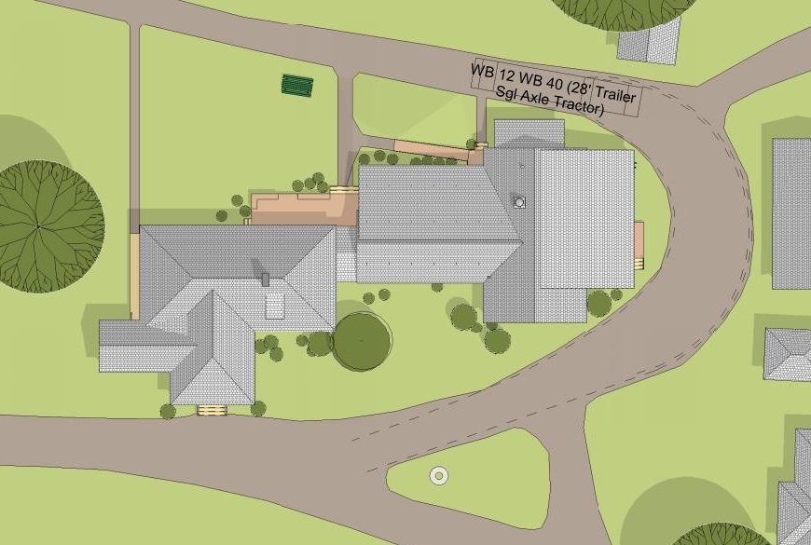
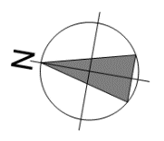
site plan
Notes:
This is a birds’ eye view of the East Plan Lodge, dining room, and kitchen.

Slide 51
site plan
let’s take a visual tour
site plan
Notes:
To give you a real sense of what the outcome of this project will look like, we need to take a visual tour. So, let’s go!

Slide 52
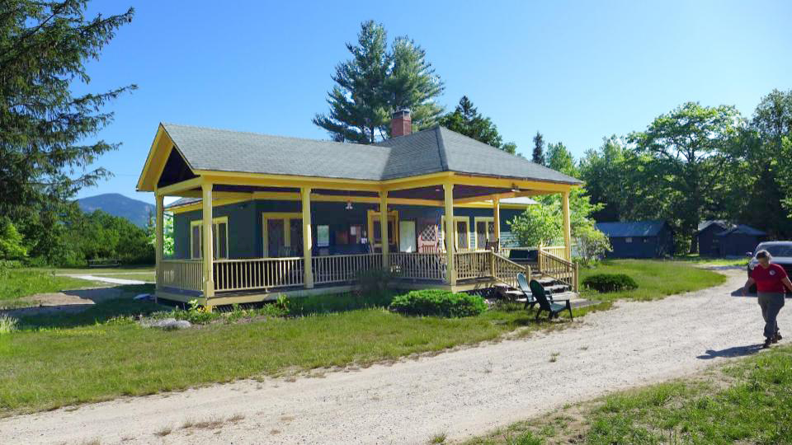
existing southwest arrival view
Notes:
This is the typical view (not including the person walking in the road and the two plastic chairs sitting on the lawn in front of the Lodge) of the Lodge that you would normally see as you arrive at Camp.

Slide 53
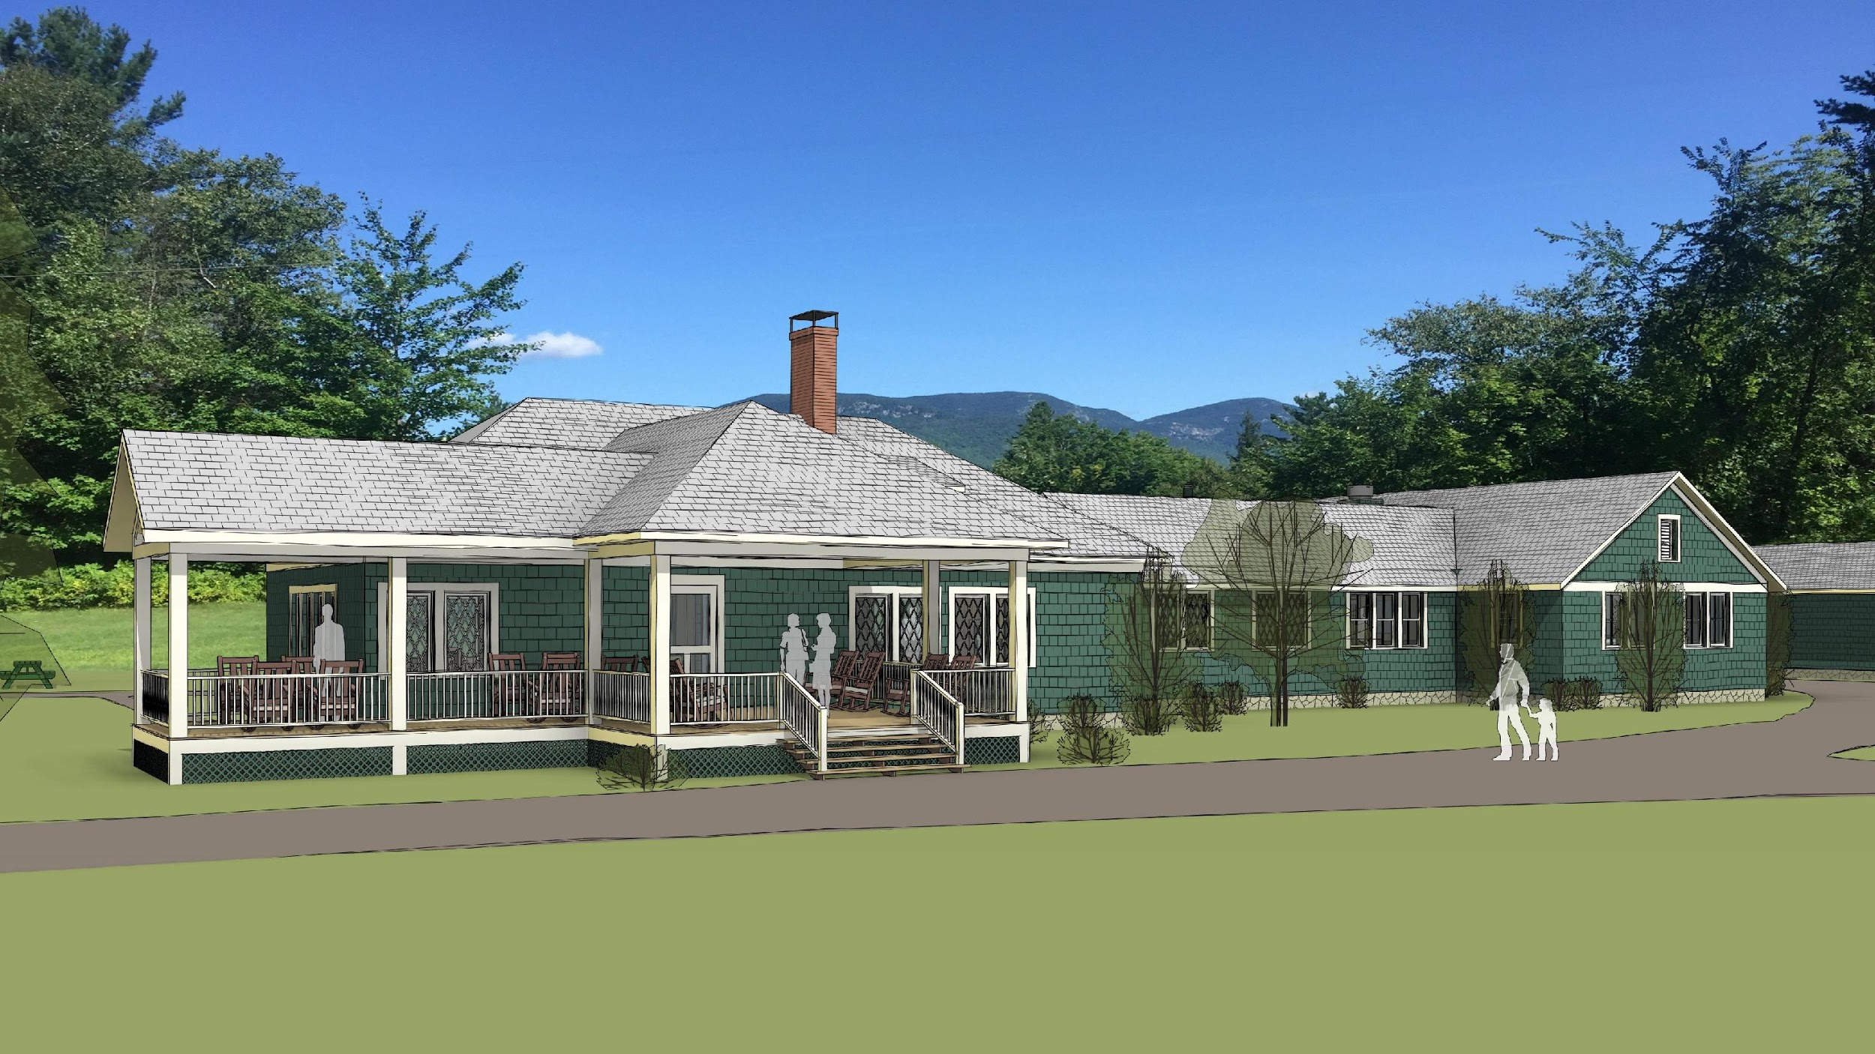
new southwest view
Notes:
Here is a similar view of the Lodge (computer generated) showing the southwest view with the new dining and kitchen areas built.

Slide 54
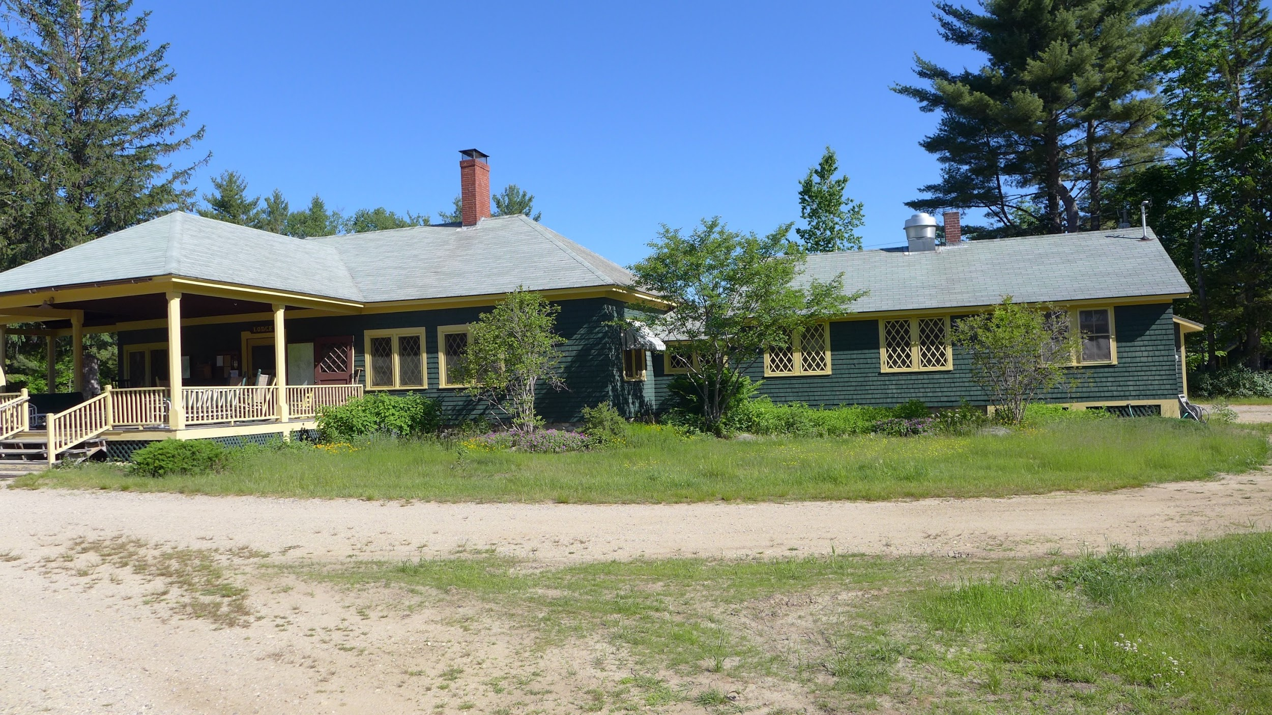
existing south view
Notes:
Let’s look again at the southeast view of the existing Lodge on this slide and… (next slide)

Slide 55
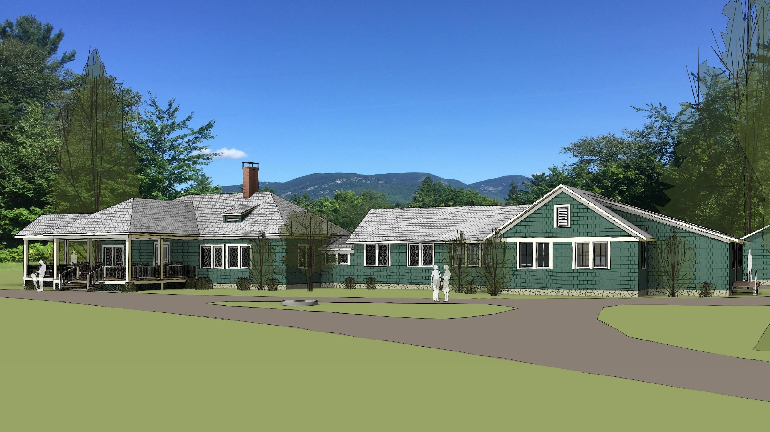
new south view
Notes:
This new south view shows what the new finished Lodge/dining/kitchen.
Let’s look at some other views to see more of the outside details in the next set of slides. We will first look at what is there today, and then you will be able to see what the comparable view would be after this new construction is complete.

Slide 56
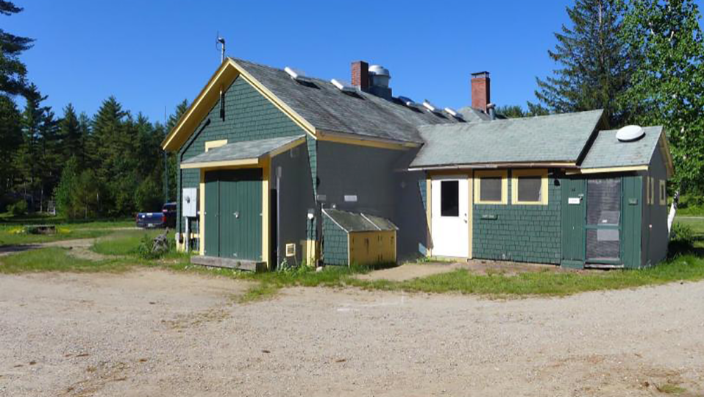
existing northeast view
Notes:
Does this area look like it needs some tender loving care? Close up of additions added to the Lodge over the years. The eastern end of the kitchen (added in 20s-30s) and the ice machine/bathroom built in 1939 can be seen, as well as the small shed on the end of the eastern section of the kitchen housing the Camp’s electrical panels added in the last 20 years.
All of the food from the Sysco food trucks is unloaded here and carried into the kitchen through the white door, which includes going up a small set of stairs inside the building.

Slide 57
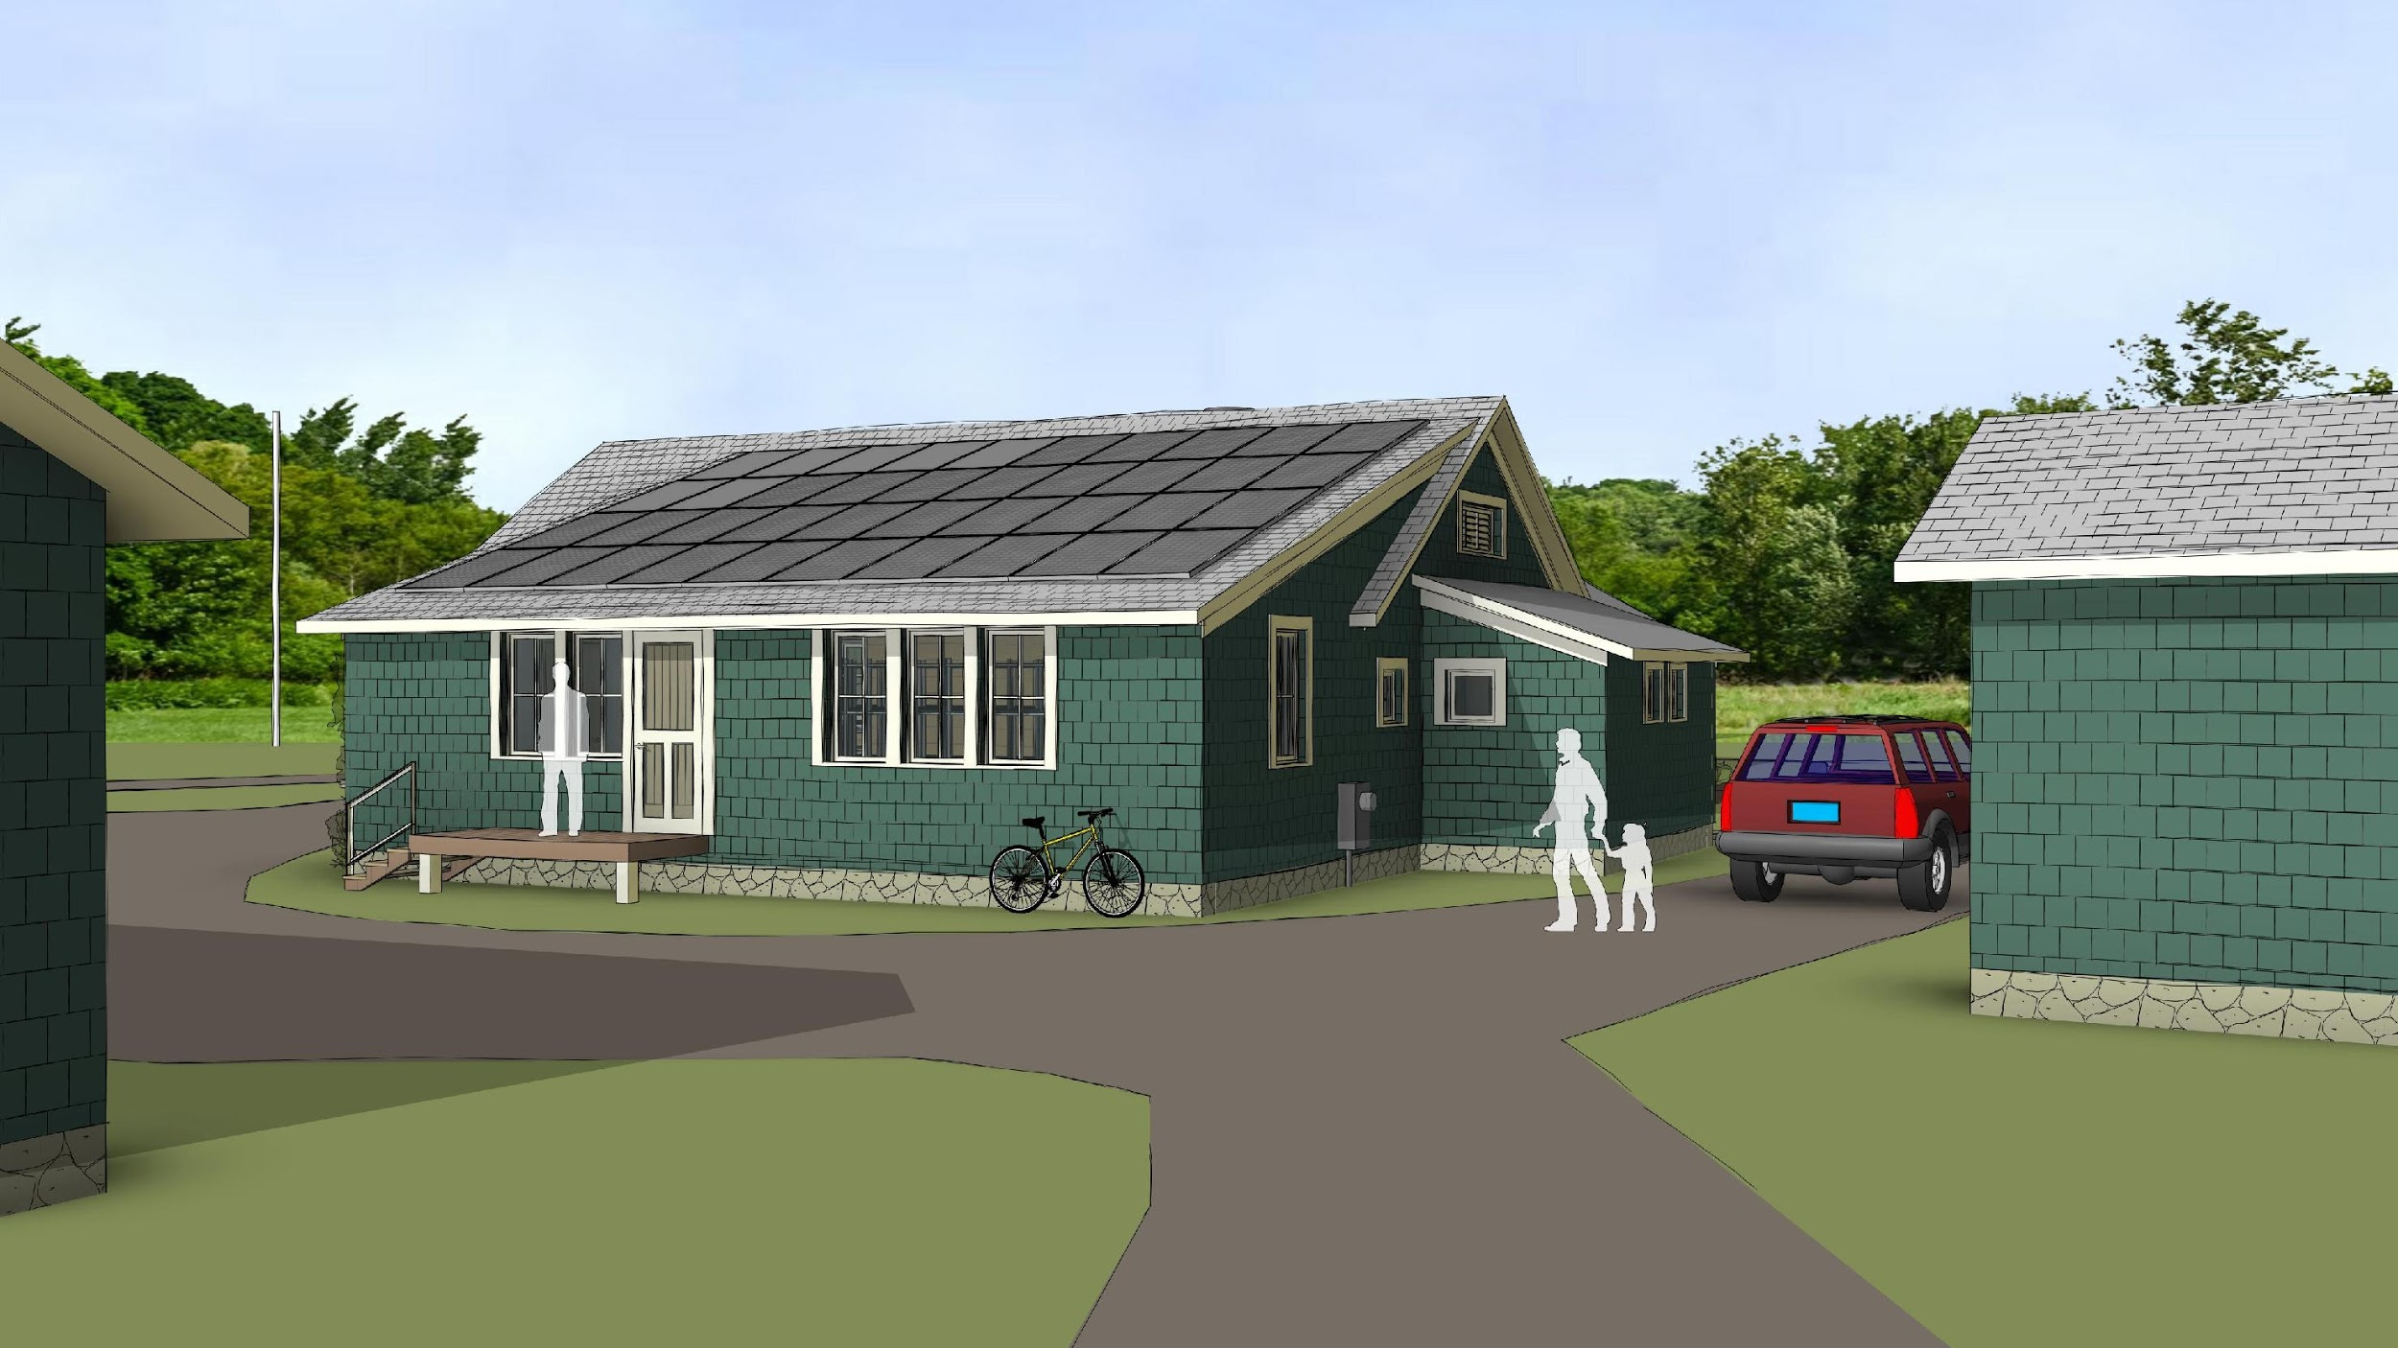
new northeast view
Notes:
This same northeast view shows the door into the kitchen from the east. There is a small loading dock in front of the door which will allow the Sysco food truck to pull in and unload. The entire kitchen will be at the same level so no need to go up stairs when bringing the food into the kitchen.

Slide 58
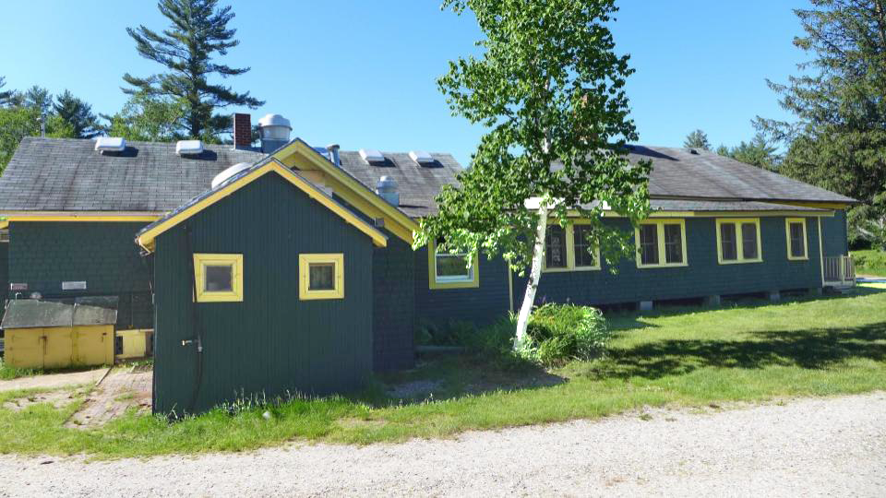
existing north view
Notes:
Here is the “back” of the building with the dining porch on the right ,and the bathroom/ice machine building in the middle.

Slide 59
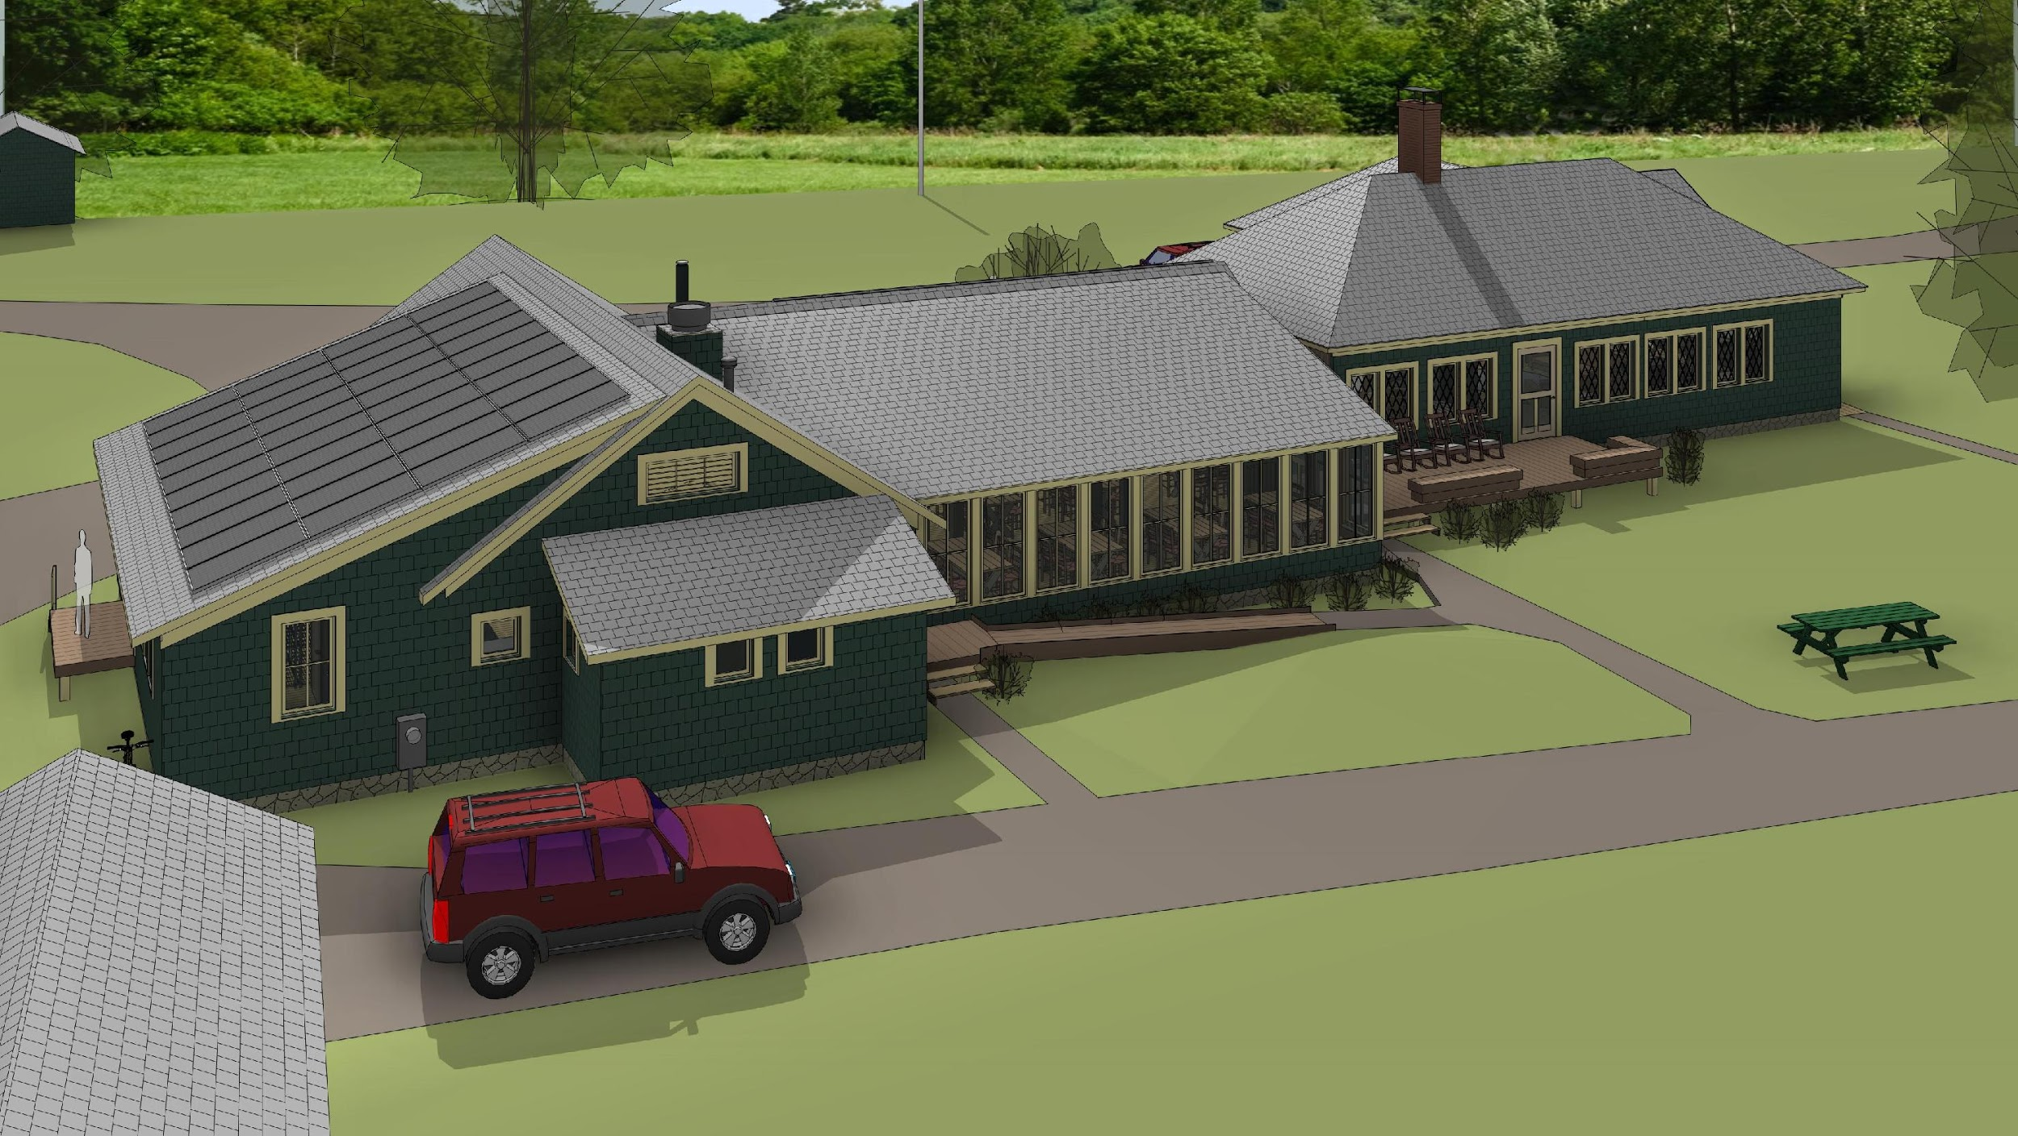
north aerial
Notes:
A higher angle view shows the northern back of the new kitchen and the dining area. The small building in the middle houses two ADA compliant bathrooms. Note the ramp and stairs providing outside access. They can also be accessed from inside the building as you will see later.

Slide 60
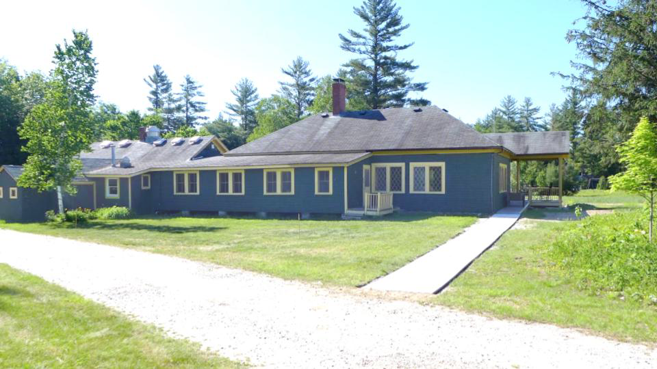
existing northwest view
Notes:
Photo highlighting the existing northwest view with the prominent dining porch.

Slide 61
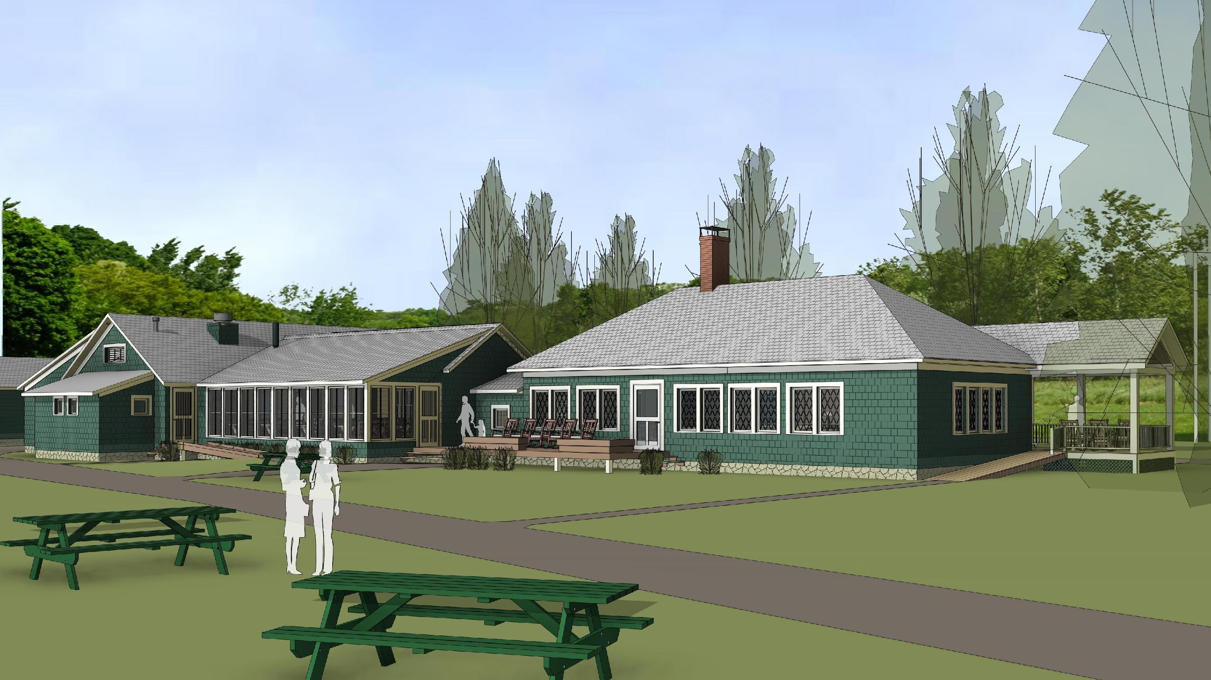
northwest view
Notes:
Here is the same northwest view. Note the old dining porch is removed and the Lodge structure is similar to the original 1908 building.

Slide 62
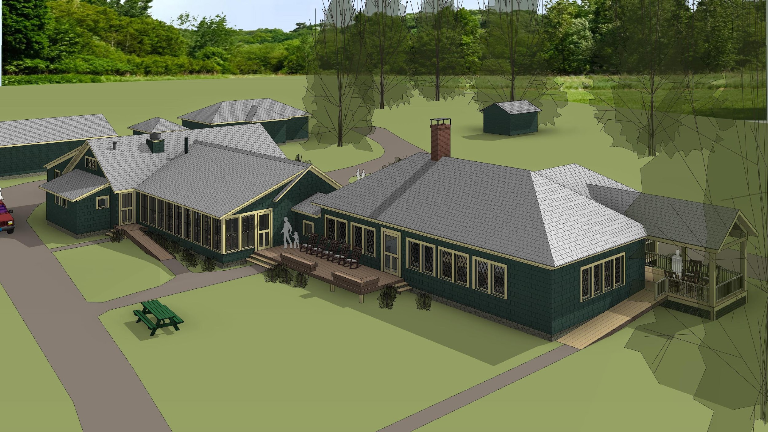
northwest aerial
Notes:
An aerial view showing more of the structure.

Slide 63
Summary of PWWG East Design Advantages
Site and Overall Building Layout
Maintains entry arrival views | Additions are located at the east of the Lodge, back away from the south face of the Lodge, so existing arrival views are unchanged
Increases natural ventilation and light | Expansion along east/west axis, like original Lodge, promotes sustainable strategies of natural ventilation and daylight to help occupants connect to nature. Restores four historical windows at north wall, east of fireplace, bringing back added light & ventilation.
Maintains domestic scale | Continues domestic (vs. institutional) scale of Conant Lodge’s building forms and room sizes.
Restores traditional forms and structure | Restores the Lodge roofs to their original forms and improves roof drainage
Notes:
The following is a bullet point summary of the advantages of the East Design as provided by the architects, PWWG.
Some of the advantages include: maintaining entry arrival views, increasing natural ventilation and light, maintaining scale, and restoring traditional forms.

Slide 64
Summary of PWWG East Design Advantages
Site and Overall Building Layout (continued)
Increased Views North & South | Dining room location increases north facade building length for guests, providing north views up Evans Notch and more south views at the dining room with seven window units..
Carbon Reductions | 40 to 60 solar panels in two arrays (east and south dining roof) meet a significant portion of CRC electrical needs.
Strengthens North Lawn Connection | The combination of north porch, north views, north walkway access, and plantings activate this side of the building.
New Cool Roofing | New dimensional “cool roof” shingles recall original wood shingles and help reduce heat gain
Notes:
Other advantages include: new cooling roof, carbon reductions, increased views north and south, and strengthens north lawn connection.

Slide 65
overall plan - east expanded
overall plan
Notes:
Let’s first review the general floor plans. This allows you to clearly see each of the components of the Lodge including the enlarged social area, the dining space, and the new expanded kitchen

Slide 66
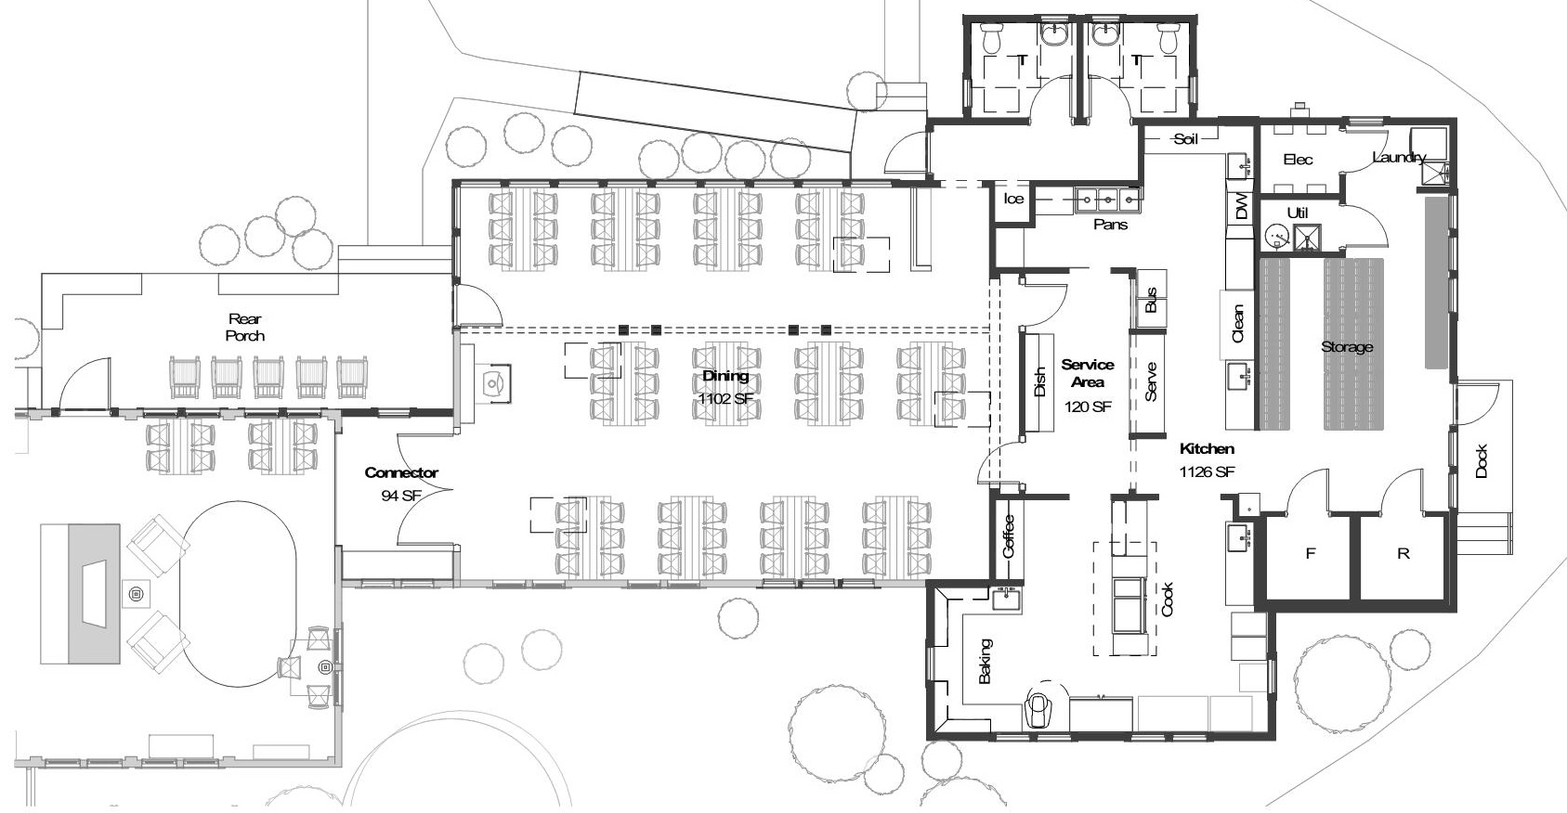
enlarged plan - east
enlarged plan
Notes:
This slide shows an enlarged view of the expanded social area behind the fireplace in the main Lodge. This area will also be used for the trail lunch preparation.

Slide 67
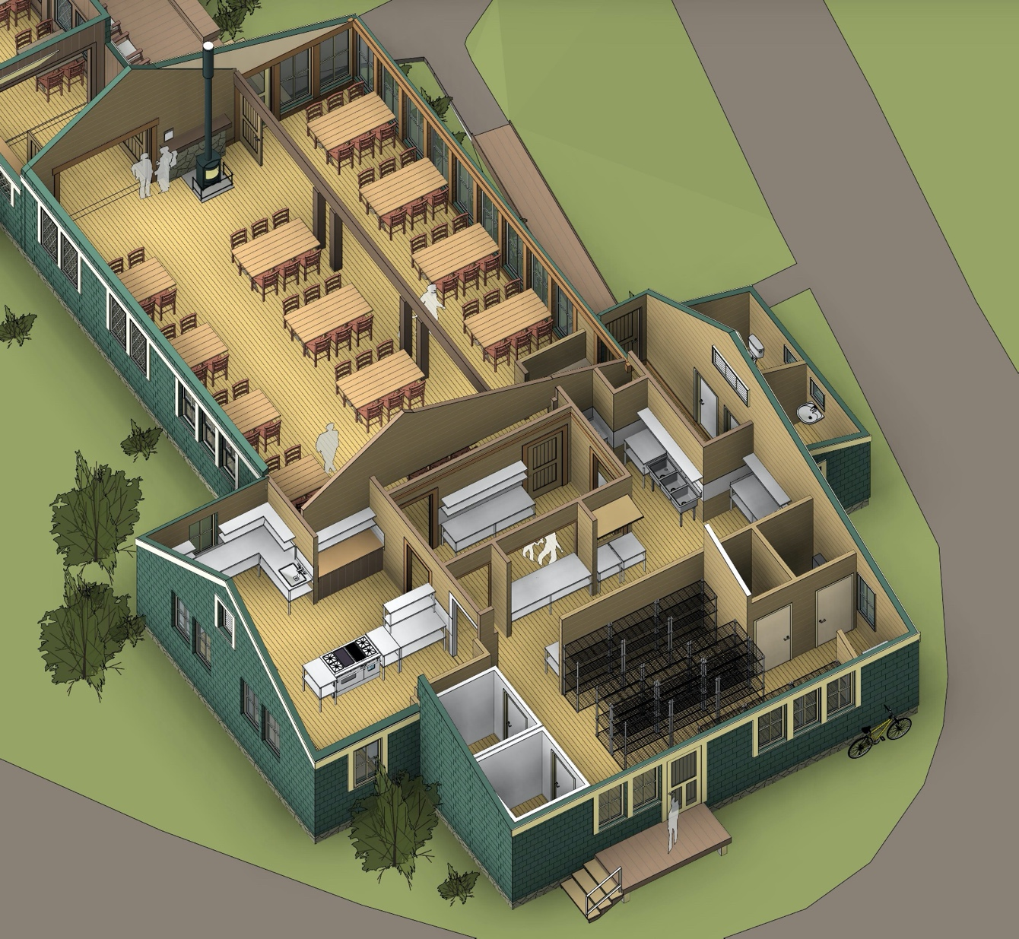
let’s take a tour . inside
axonometric
Notes:
Now that you have seen the outside, let’s go into the new building and see how everything looks and feels from the inside.

Slide 68
kitchen layout
Notes:
Let’s focus first on the Kitchen. We have a tentative layout. Our plan is to spend more effort on this, including working with an additional kitchen designer to develop a final plan.

Slide 69
Summary of PWWG East Design Advantages
Kitchen
Improve function | Single level, new kitchen addition for food service functions: cook, back, serve, clean, etc. for efficiency, worker safety, and easier food deliveries.
Efficient service flow | Maintains a spatial relationship and server flows between the kitchen and dining area similar to current operations.
Accommodate Extension and shoulder season | Potential for in-kitchen pickup and drop-off during self-service times.
Support spaces added | Storage, utility, laundry, and electrical panel closet provided.
Finishes and equipment | New surfaces, counters, and food service equipment.
Notes:
Kitchen will have functional improvements, more efficient service flow, better accomodation for Extension and shoulder season, additional support space and new finishes and equipment.

Slide 70
new kitchen
enlarged plan
Notes:
The new kitchen is east of the dining area highlighted by the red. One level operation versus two levels in current kitchen.
Benefits include: 1. More efficient operations, 2. Better ventilation, 3. Improved working environment, 4. New special service area space allowing guests to enter during Extension and the shoulder season to get their self-service meal without interfering with the operations.

Slide 71
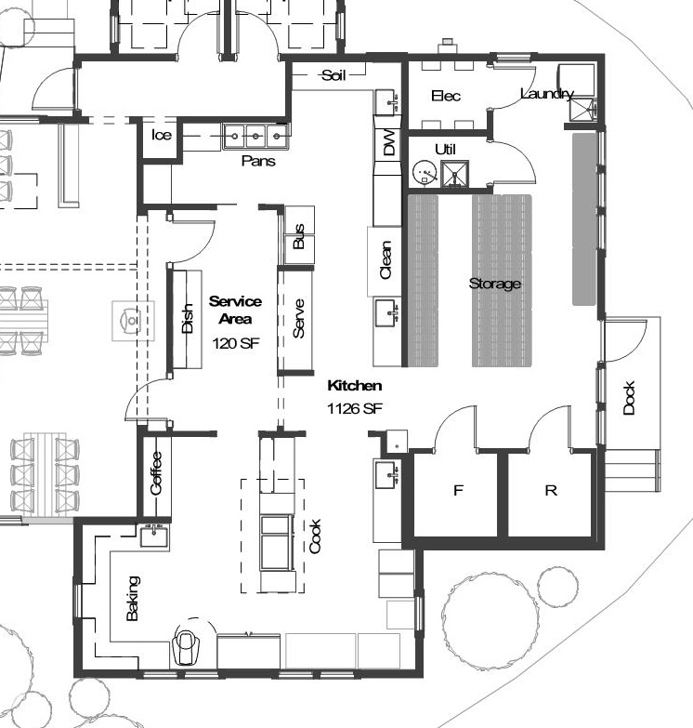
Dish Washing
Dry Storage
Serving Pantry
Walk-in Coolers
Baking Area
Cook Line
kitchen plan
Notes:
This is our tentative floor plan for the kitchen. The old kitchen used a cellar for some food storage that is no longer tenable. A better solution is to have the food storage on the same level as the kitchen. The new kitchen has about 39% more square feet than the old to accommodate food storage, a more efficient and effective layout, a service area for guests to get their food in the kitchen during Extension and the shoulder seasons, all on one level.

Slide 72
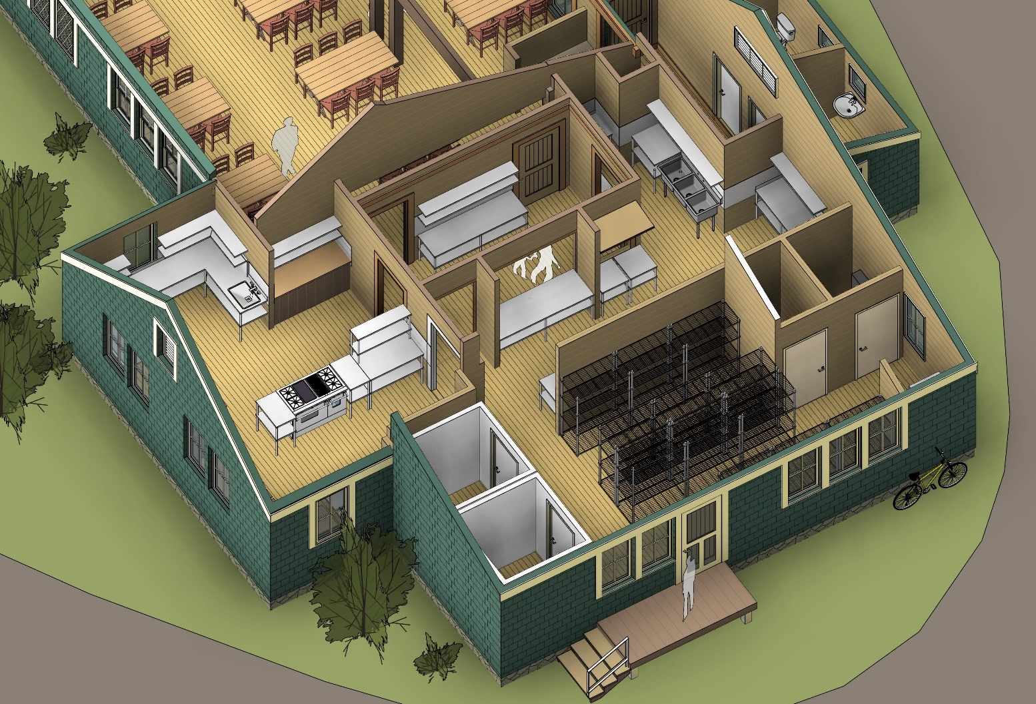
Serving Pantry
axonometric
Notes:
Here is an aerial view of the inside of the new kitchen. Note the storage space in the eastern (back) end. You can see the serving pantry (note the two figures) can be seen in the western middle section of the kitchen.

Slide 73
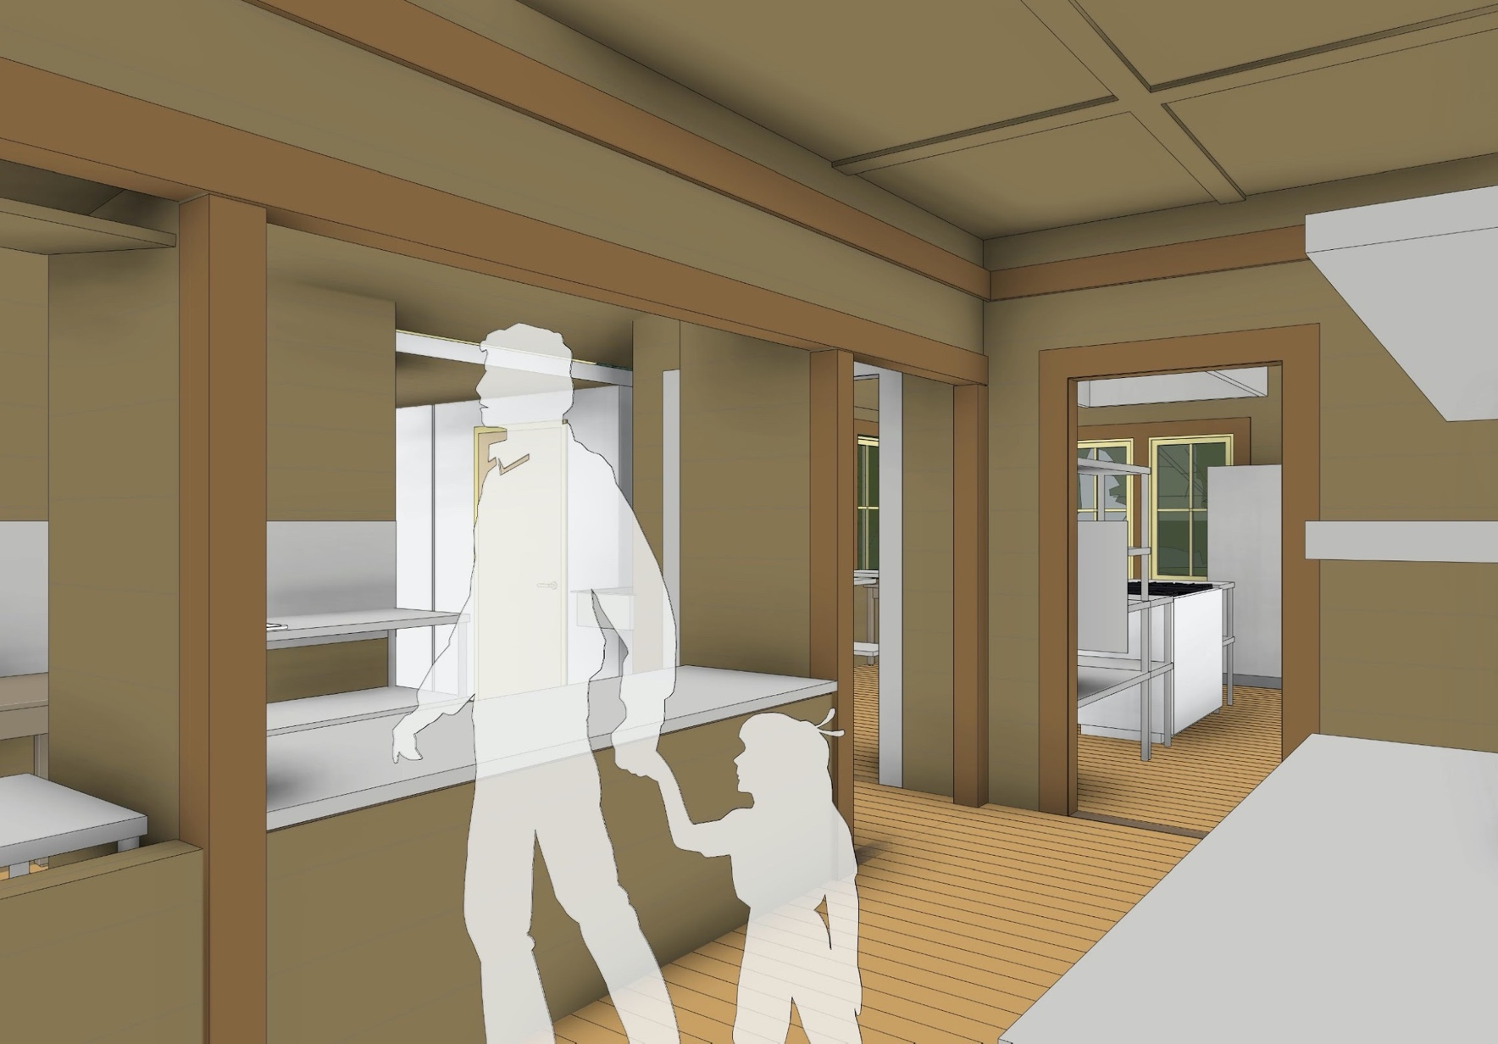
serving pantry
Notes:
This is a close-up of the service area, or serving pantry, where guests can pick up their food during times of self-service (Extension and the shoulder seasons).

Slide 74
Summary of PWWG East Design Advantages
Accessibility
New Bathrooms | Two ADA compliant bathrooms which are accessible from the dining room and from service road. Located to take advantage of natural ventilation.
Dining Room | Access from north road, 5% accessible seating (four seats) without loss of seating capacity.
Notes:
Accessibility is improved with two new ADA compliant bathrooms with entry from inside and outside the building and in the dining room.

Slide 75
new bathrooms
enlarged plan
Notes:
The east plan also provides space for two new ADA compliant bathrooms. These bathrooms can be accessed through a short hallway off the dining area as well as from outside the Lodge with a ramp leading to door into the hallway.

Slide 76
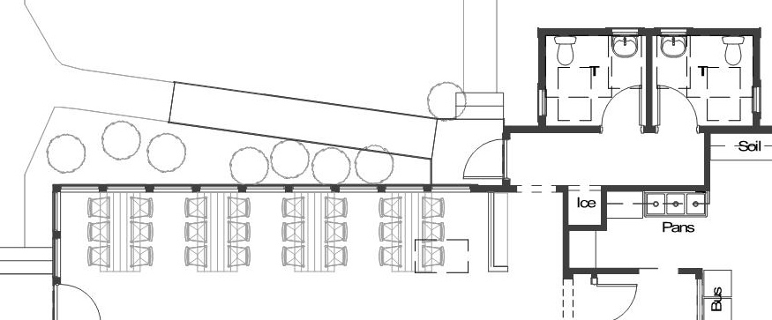
new bathrooms
Notes:
This provides you with a sense of the access to and location of the two new ADA compliant bathrooms. They can be accessed from the northeast end of the new dining area, or from outside on the north side of the building.

Slide 77
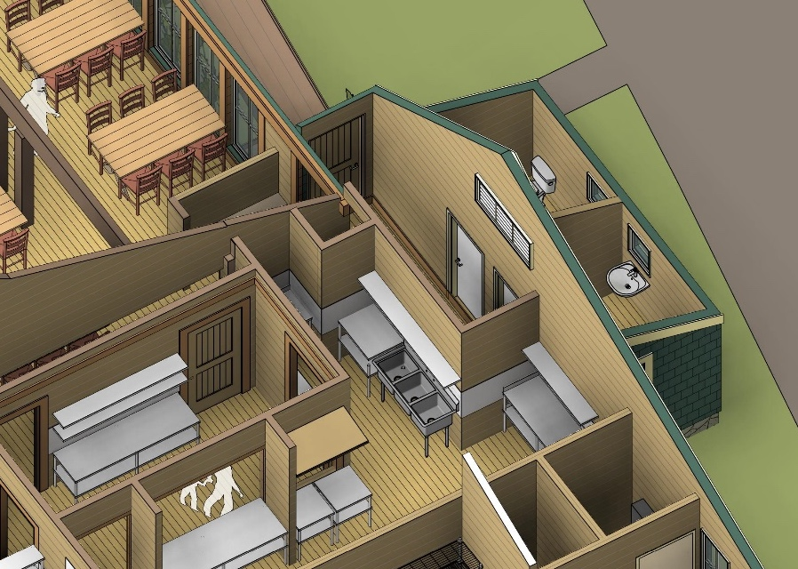
axonometric
Notes:
Here is better view of the bathrooms and their accessibility. Also note, they are positioned to maximize the use of natural ventilation.

Slide 78
dining room layout
Notes:
Now let’s take a closer look at the dining room. The structure of the new dining room resembles the existing dining area as you will see in the next few slides.

Slide 79
Summary of PWWG East Design Advantages
Dining
New Dining Room | Repurpose original/existing kitchen shell for new dining area with new north porch-type addition similar to current north dining porch
Continue Architectural Integrity | Traditional materials, stains, and timbers to create a new dining room with a similar feel to existing dining areas.
Table Layout Options | Anchored” tables ends to wall or columns with options for additional layout. Serving continues at end of each table
Additional Circulation Area | Additional space between tables and serving aisle widths that exceeds code minimum and provides for slightly less crowding.
Notes:
A new dining room with a similar look and feel to the existing dining area will repurpose the space of the old kitchen. The table layout provides anchoring of tables, and additional space for ease of entry for guests.

Slide 80
Summary of PWWG East Design Advantages
Dining
Improves acoustics and sight lines | Use of double columns and low beam differentiates space while allowing guests to hear and see speakers. Acoustic panels between rafters absorbs sound.
Service | Similar serving travel distances to the current dining area. Server tray stand storage also provided.
Notes:
The new dining area will have improved acoustics, good visibility of the speaker for all guests, and similar travel distances to current dining for crew.

Slide 81
new dining room
enlarged plan
Notes:
The new more spacious dining room is located inside the upgraded structure of the old kitchen. It maintains the current dining seating space of 12 tables of six people each. The existing dining area is not ADA compliant, but this new dining space will be ADA compliant with space for at least four wheel chairs (or over 5.5% of the available seats, above the ADA requirement). There will also be more space between the tables allowing for easier access.

Slide 82
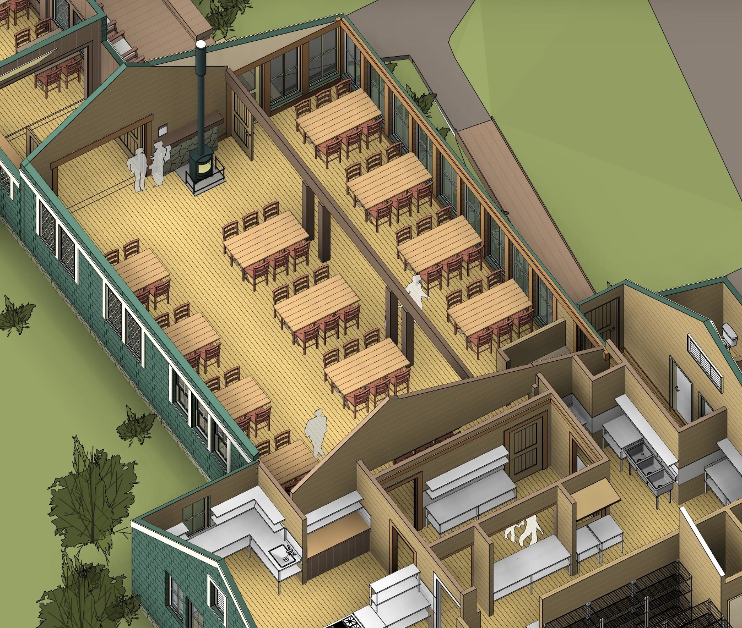
axonometric
Notes:
This is a view of the dining room showing the 12 tables with six people at each table adjoining the new kitchen. Eight of the tables are anchored by the north or south walls.
This area has a small wood stove at the western end. Announcements would be made near the stove, and the speaker would have clear visibility to all of the 12 tables in the dining area. This should result in an improvement in the ability of guests to hear more clearly.

Slide 83
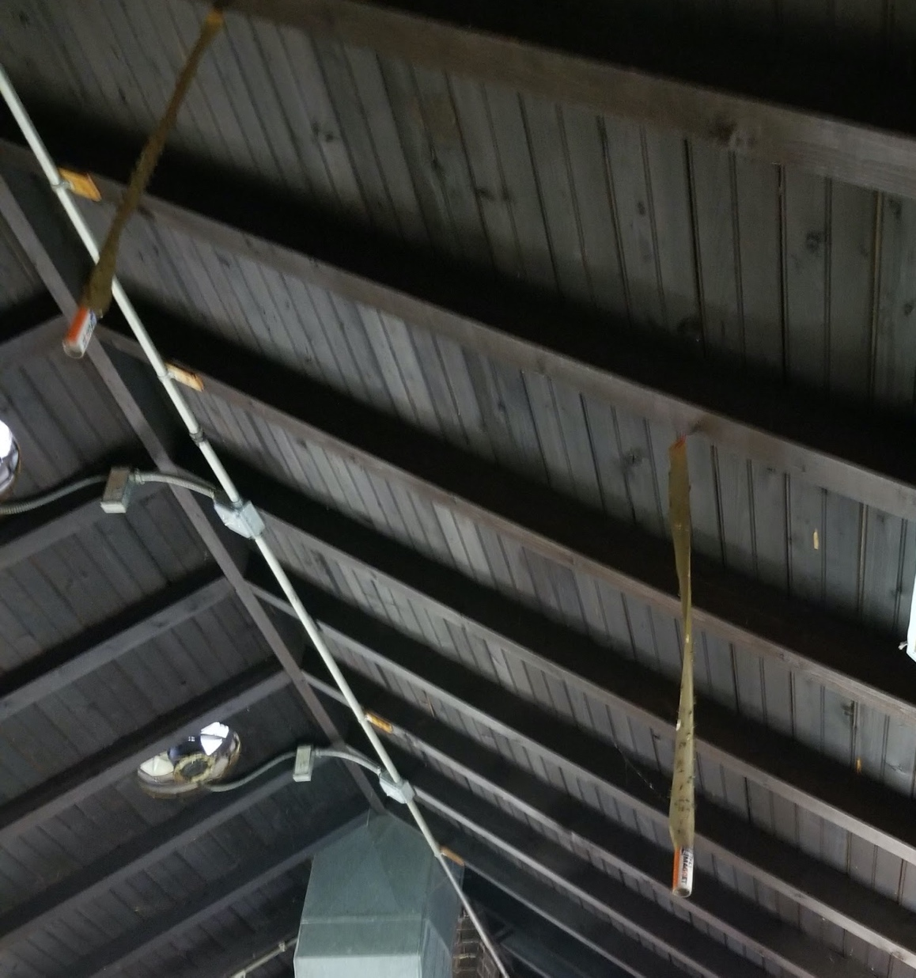
retain existing
kitchen roof
structure
historical 3” x 4”
rafters with
tongue and groove beadboard
sheathing
Notes:
The new dining room will retain the current kitchen roof structure. This is a photo of the current kitchen roof from the inside.

Slide 84
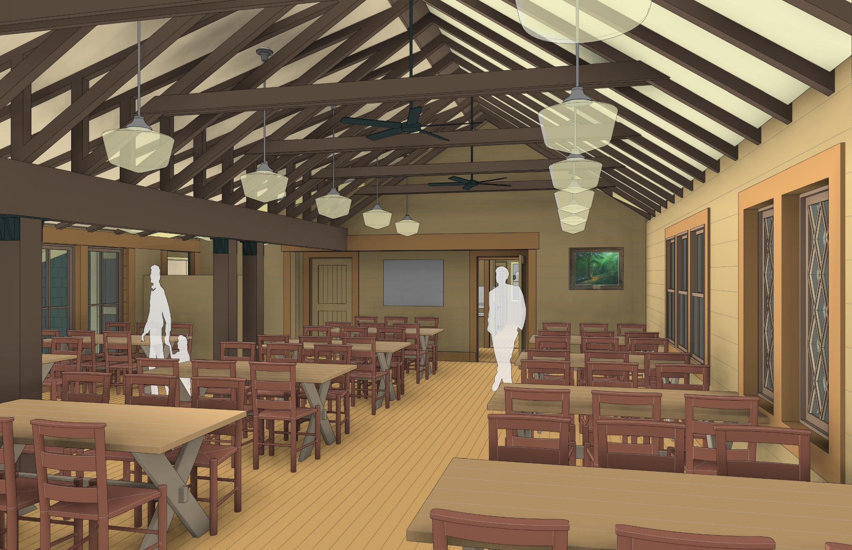
dining
view
east
Notes:
This is looking toward the east into the new dining area, showing the ceiling structure. We plan to place the appropriate sound dampening material in this room to control the overall level of noise. The doors that you see in the back lead into the new kitchen.
Though one dining room, there will be three main areas: an alcove-like area to the far left in this view, which is similar to the dining porch; a center section, and the southern section in which the tables are anchored by walls/windows on the right.

Slide 85
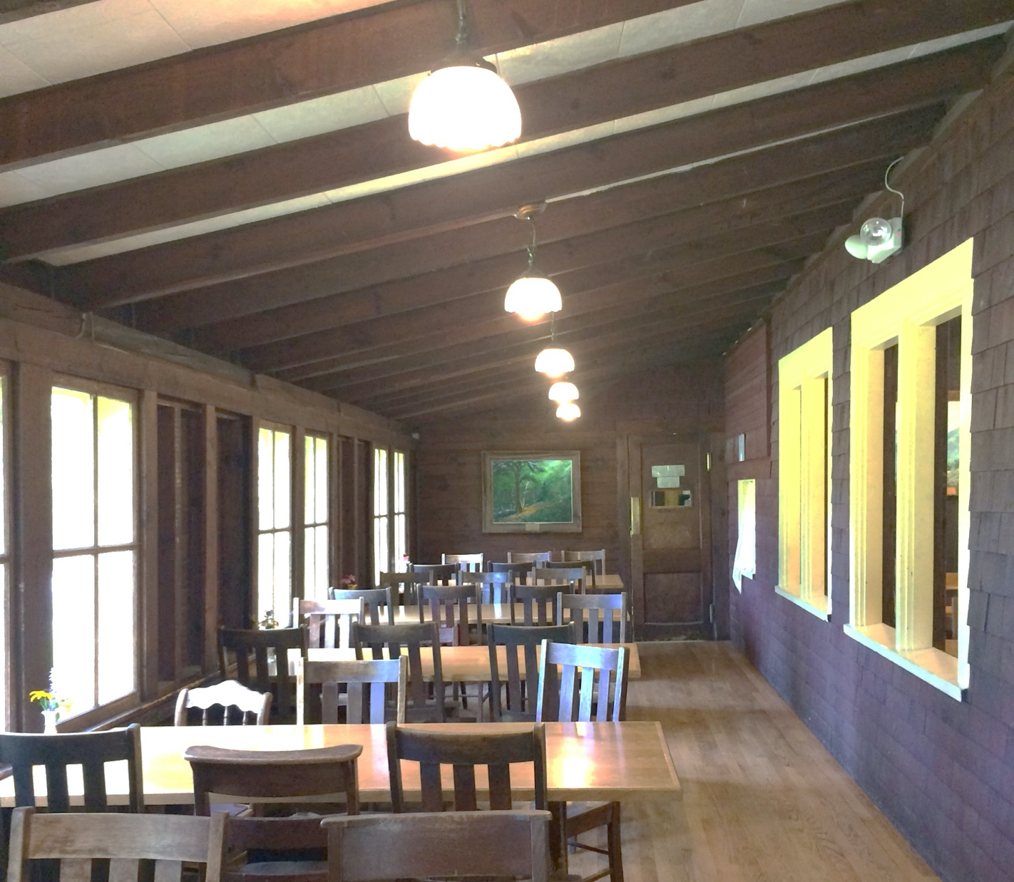
existing porch
view
east
Notes:
This is a recent picture of the dining porch looking east.

Slide 86
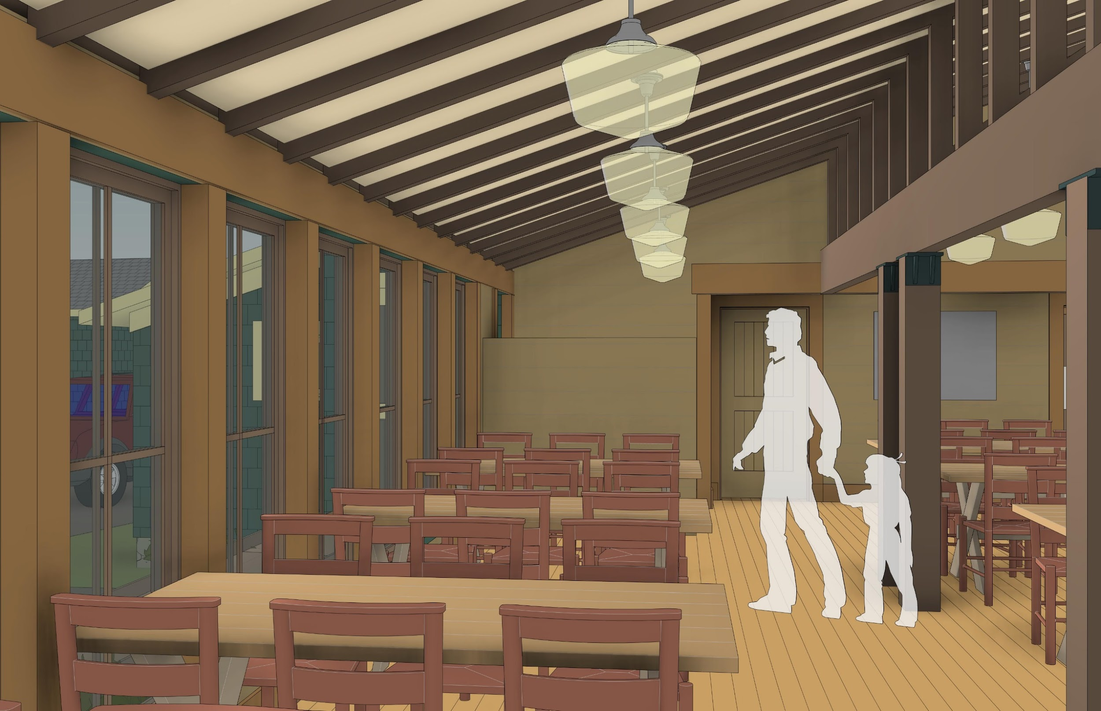
new
dining
view
east
Notes:
Here is the same view within the new dining area. In some ways, this area is will mirror the old dining room porch area.

Slide 87
sidebar alternatives #1: dining room center anchor wall
center tables anchored on half-wall vs. unanchored center tables
Add a half-wall ensuring that every table is wall anchored?
This feature replicates the current dining porch half-wall and helps to break up an institutional dining hall for a more intimate domestic dining room.
Notes:
All of the design slides that you have seen so far were recommended by the architects. The Lodge Planning Committee formerly approved of these plans in a Committee vote on June 15, 2019. There were only three minor areas where the Lodge Planning Committee and the PWWG architectural design plan differed. We will quickly discuss these in the following sidebars.
The PWWG plan envisions eight of the twelve tables anchored to a wall/window. Of the remaining four tables in the middle of the dining room, two would be anchored by double pillars but two tables would have no anchor.
The Planning Committee agreed to create a low half wall between the two pillars in the center to provide an anchor and help break up the potential institutional feel.

Slide 88
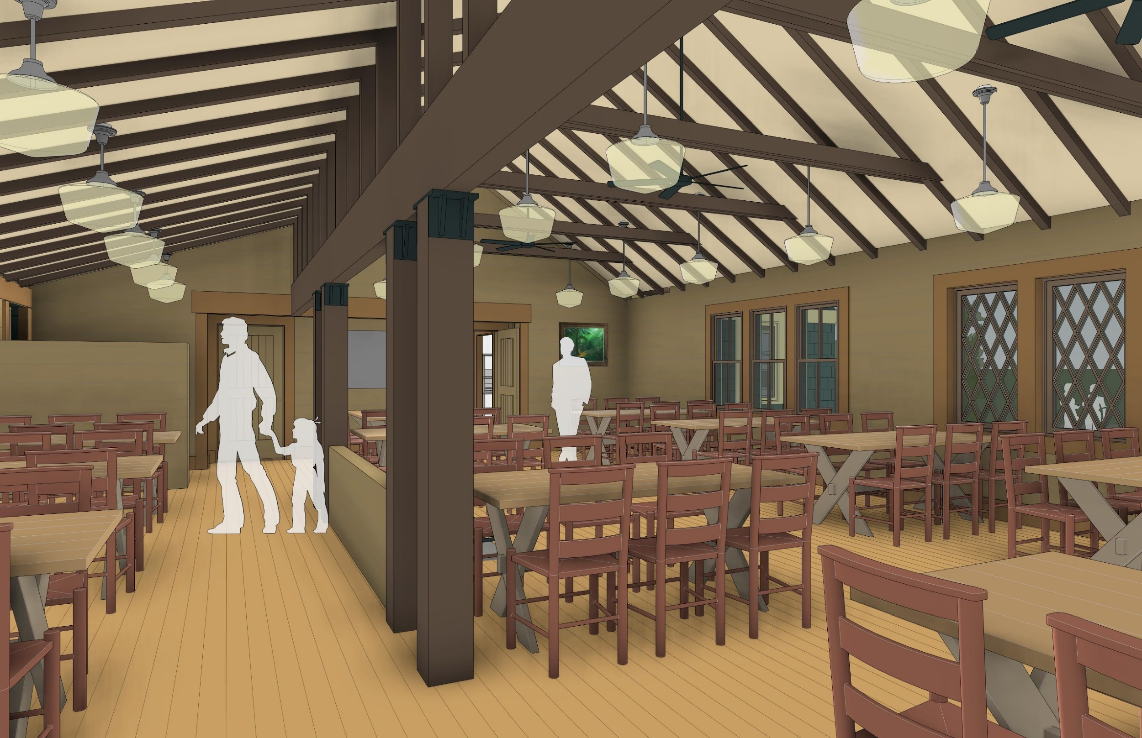
dining
view
east
low half wall
Notes:
Here is a view showing the low-half wall.

Slide 89
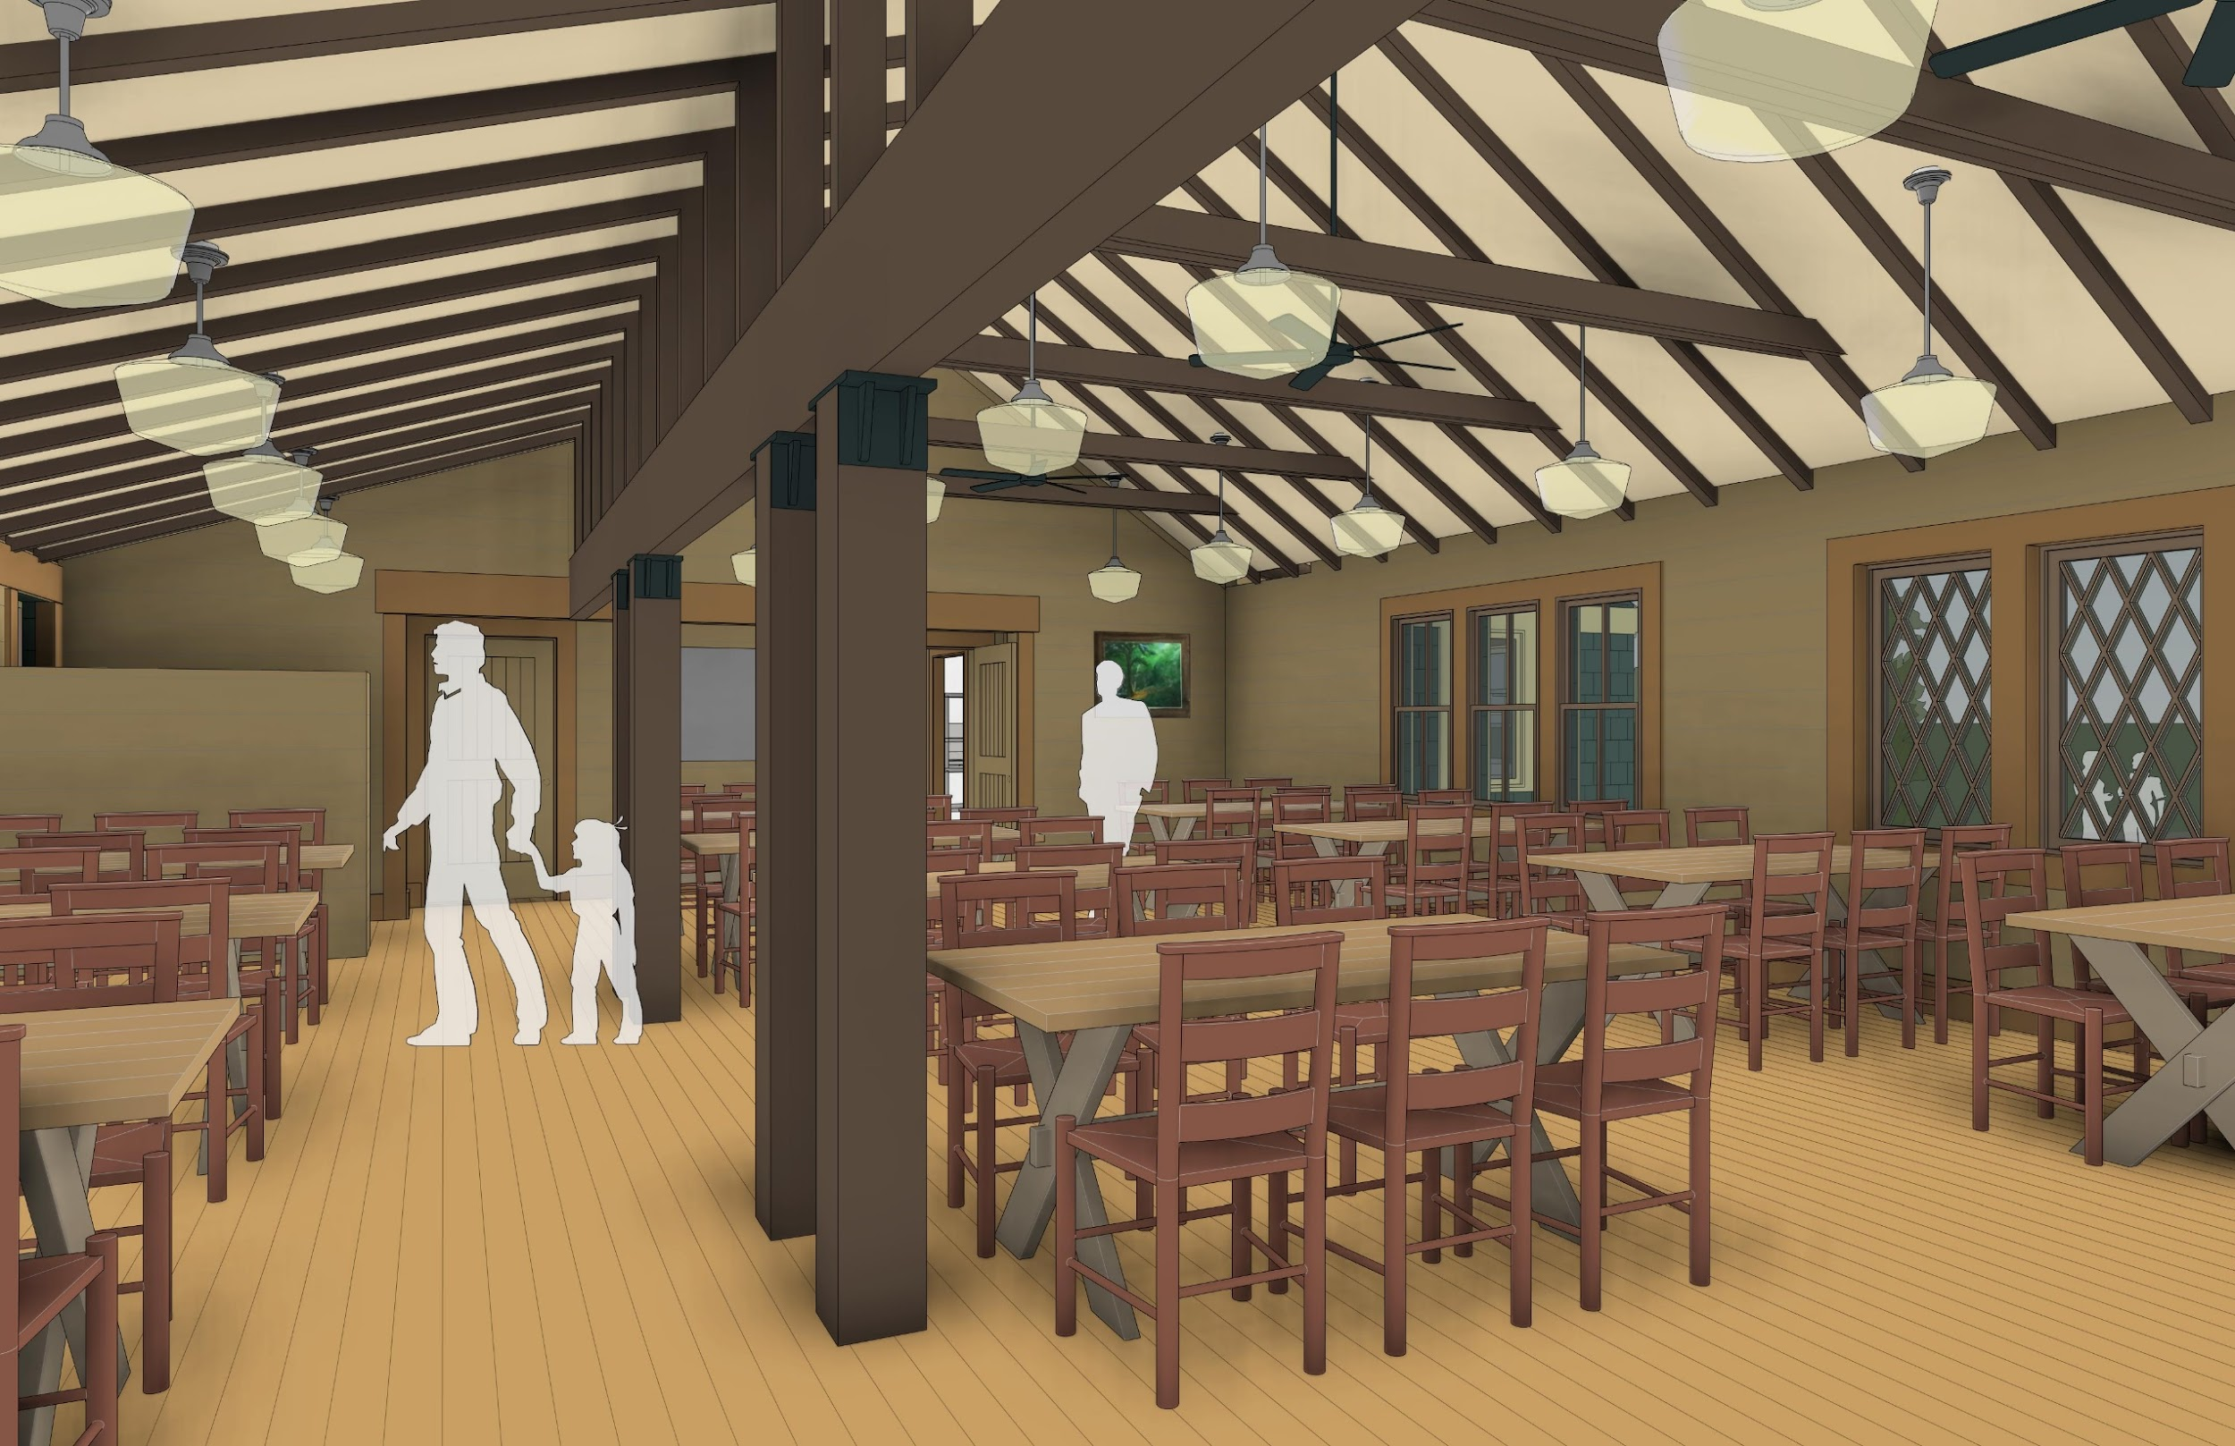
dining
view
east
Notes:
For comparison, here is the view without the low-half wall, which was in the original PWWG recommendation.
Let us know at the end of the presentation if you have comments/suggestions regarding the half wall.

Slide 90
sidebar alternatives #2: dining hall stove locations
west vs.
center vs.
southeast
Where best to provide stove heat, to keep guests safe, to maintain good crew workflow, and to help break up institutional dining hall for a more intimate domestic dining room feel?
West? Center? Southeast?
Provide heat, keep guests safe and good crew workflow, and help break up institutional dining hall to maintain dining room feeling
Notes:
The PWWG plan recommended a center-located stove in the dining area. They felt this would be the most heat-efficient location, and could serve as a gathering spot during non-meal times. The Lodge Planning Committee decided for safety and other reasons that a west-located small wood stove would be preferable. One other possibility is a south east location.

Slide 91
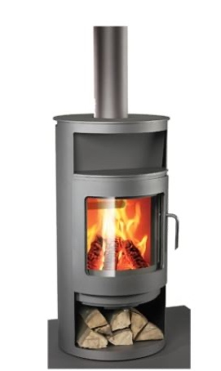
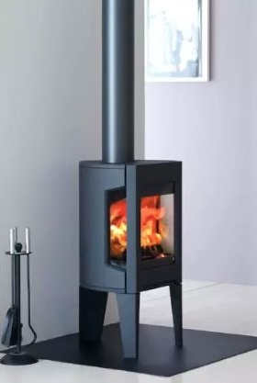
type: wood burning stove
coverage: 1100 sf min.
small footprints: 20” x 20”
safety: typically glass is the only surface to get hot – verify with mfg.
select decorative unit, especially if back of unit is exposed
dining room stove
Notes:
This is just an example of the type of wood stove that is being considered. We will need to do further research before making a final decision.

Slide 92
west
stove
Notes:
Here is location of the west stove in the floor plan.

Slide 93

dining
view
west
Notes:
Here is a view looking at the west stove next to the entrance. The speaker before meals would stand to the left of the stove to make announcements.

Slide 94

center
stove
Notes:
A center located stove would provide more efficient heating, but would be near guest tables.

Slide 95

dining
view west
center
stove
Notes:
Here is a view of the center located stove

Slide 96

southeast
stove
Notes:
Another possible stove location is in the southeast corner.

Slide 97

dining
view east
southeast
stove
Notes:
View of the southeast located stove from inside the dining room.
Do you favor the West location or do you have another opinion? Let us know at the end of the presentation.

Slide 98

dining
view
west
Notes:
Let’s get ready to go into the Lodge. Before we go, here is a view at the west end of the dining area looking into the new multi-use social area behind the fireplace in the Lodge.

Slide 99

dining
view
east
Notes:
Here is the short walk-thru from the Lodge multi-use social area into the new dining room. Note: the large doors, which will largely remain open, are fire doors, as required by code. No sprinkler system will be needed.

Slide 100
main lodge layout
Notes:
Now we will switch gears, and focus on the main Lodge layout.

Slide 101
Summary of PWWG East Design Advantages
Social Area/Lunch Packing
Relocates trail lunch packing | Relocates portable lunch packing functions and guest cubbies to the east area of the fireplace with direct adjacency to dining room and servers.
Expands social area | Increases ability for informal seating at west end of Lodge and a new social area east of the fireplace.
Increases guest social places | Adds a north porch and fireplace east into the guest mix
Notes:
The new design expands the social space and relocates the trail lunch packing area. It also provides guests with a north outside uncovered porch.

Slide 102
expanded social area
enlarged plan
Notes:
The social area of the Lodge will be expanded greatly as the area behind the fireplace can now be a multi-use space with enough room for the trail lunch and for social space.
The trail lunch tables will remain temporary in nature (assembled in early morning, and removed in late morning) providing for extra room during most of the day.

Slide 103

main lodge plan - east
overall plan
Notes:
Here is a floor plan highlighting the main Lodge in the east plan. Let’s focus on the area behind the fireplace, which was formerly a dining area. As you can see, there is an entrance into the new dining area (1). You can go out to the back of the Lodge through a door to the rear porch (4).
This area will serve as a multi-use space, though most of the time it will serve as a mainly a social area. There is space for the trail lunch tables, which will be removed by late morning. The cubbies that were formerly in the northwest corner of the Lodge will be moved into the southeast corner providing easy access for the morning trail lunches, and added space in the west end of the Lodge..

Slide 104

fireplace
east
area
Notes:
This area behind the fireplace in the Lodge was previously used as a dining space. This will be a multi-use space that will include a social area during most of the day. The trail lunch tables (which might eventually include temporary cold tables) will be here before and slightly after breakfast, and then removed until the next day.

Slide 105
remove old dining porch & restore original lodge
enlarged plan
Notes:
The old dining porch, which has major structural issues, will be removed. This will result in the return of the north wall of the Lodge closer to its original 1908 configuration with improved northward views.

Slide 106

north porch
Notes:
If we exit the new multi-use social area into the back of the Lodge we arrive at a new outdoor north porch.

Slide 107
sidebar alternatives #3: solar photovoltaic locations
east & south vs.
east only
Solar panels are scalable.
There are multiple placement options for solar panels around Camp.
Should solar panels be placed on south roof? Or not here to help preserve the rustic aesthetics of camp?
Notes:
Based on preliminary work of the Lodge Planning Committee, it was determined that we would need to have 60 solar panels at Camp to meet most of CRC’s electrical load. The architect’s plan involved having panels on both the south and east roofs of the new dining area and kitchen. The Planning Committee leaned toward having them only on the east roof.

Slide 108

south aerial – with east facing solar panels
Notes:
Here is a view showing the solar panels only on the east roof.

Slide 109

south aerial - with south and east facing solar panelsl
Notes:
Here is aerial view with solar panels on both the south and east roofs. Please note that the panels on the east roof will not operate as efficiently as those on the south roof due to the direction and path of the sun during the day.

Slide 110
southwest view – with east facing solar panels
Notes:
This is what you would see if you were looking directly at the Lodge with the solar panels on the east roof only.

Slide 111

southwest view - with south and east facing solar panels
Notes:
Here is the same view with solar panels on both south and east roofs. What do you think? Solar panels on both roofs or just the east roof. Let us know at the end of the presentation.
Please Note: Solar panels are scalable in the sense that they can be placed on other roofs or on the ground. However, it may be much more costly to have a set of panels permanently located on the ground due to the additional support structure required.

Slide 112
AMC CRC Lodge Project Recap of Why?
Notes:
As we wrap up this presentation, let’s consider some of the main benefits and drivers of the East Plan.

Slide 113
Why? Main Drivers and Benefits of CRC Lodge Project
Integrate Solar energy as a means of reducing carbon footprint
Address required structural repairs of dining porch
Improve guest bathroom availability and accessibility (ADA compliant)
Add dining room space (ADA seating, wheelchair access, more seating room)
Provide needed facility improvements while balancing:
Camp History, Experience & Aesthetics
Greater AMC Mission
Building codes
Diversity of uses
Financial considerations
Add living room social space
P
Modernize Kitchen to increase operating efficiency and enhance working environment
EXISTING LODGE
Notes:
It addresses required structural issues, adds dining room space and increases accessibility, adds living space, improves guest bathroom availability and integrates solar power WHILE balancing Camp History, experience and aesthetics, the Greater AMC mission, building codes, diversity of uses and financial considerations.

Slide 114
CRC Lodge Project When?
Notes:
What is our timeline for this project?

Slide 115
When? Timeline and Next Steps
 | 2019 |  | 2020 |  |  |  | 2021 |  |  |  | 2022 |  |  |  | 2023
 | Su | Fa | Wi | Sp | Su | Fa | Wi | Sp | Su | Fa | Wi | Sp | Su | Fa | Wi | Sp
Summer Seasons | 101 |  |  |  | 102 |  |  |  | 103 |  |  |  | 104
CR Community feedback
Develop feasible schedule
Finalize financial estimates
Finish Detail Design Plan
AMC Project Approval
Fundraising AMC Capital Campaign
Construction Phase 1 (tentative) |  |  |  |  |  |  |  |  |  | Kitchen
Construction Phase 2 (tentative) |  |  |  |  |  |  |  |  |  |  |  |  |  | Dining Room
We are here
Notes:
As you can see, we are at the beginning of a long process, which will, if it receives final approval, will not begin construction until perhaps the fall of 2022.
The Lodge Planning and the Cold River Camp Committees have both recommended pursuing the east design pending the following: 1. Feedback from CRC Community, 2. The development of a feasible schedule with its impact on Camp; 3. Good comprehensive cost estimate with impact on Camp Revenue; 4. Affordability, which includes using funds from CRC reserve fund and getting permission from the AMC to run a capital campaign to raise the remainder; and 5. Overall approval of the project by the AMC
We cannot solicit funds for the project until we have AMC approval. Construction will then be dependent on fundraising as we must have sufficient money to pay for the construction (from fundraising and part of the Camp’s reserve fund) before we can begin.
WE ARE CURRENTLY IN THE PROCESS OF GETTING AN ESTIMATE ON THE COST OF THE PROJECT, WHICH WILL BE NEEDED BEFORE MOVING FORWARD as well.

Slide 116
AMC Cold River Camp Lodge Project Update
Questions?
Notes:
Now we have some time for Questions/Comments?
We also encourage you to go the Cold River Camp Web page to submit more questions/comments to the Lodge Planning Committee directly. You can look under the “About CRC” for the Lodge Planning Projects” section where you will find a link to submit comments/questions.

Slide 117
AMC CRC Lodge Project Thank you!
Notes:
THANK YOU!

Slide 118
appendix 1:
materials
Notes:
The material in the appendix in the following slides is for reference only, not meant as part of the main presentation.

Slide 119
selecting materials / equip
durability / Long life (100 years)
local / regional materials
natural / bio-based materials / chemical content
recycled content / responsible extraction
low / no VOC’s
acoustic properties
occupant control
energy efficiency
temperature swings (unconditioned spaces)
aesthetics – “studied rusticity”
materials / equipment
Notes:
Here is some more information on guidelines that we will be focusing on as we are moving on to the construction phase of the project.

Slide 120

continuing the CRC tradition
100 mi
radius
500 mi
radius
local / regional
sourcing
of materials
and FF&E

Slide 121

living
building
challenge
criteria
as guide
materials

Slide 122
exterior materials

Slide 123


shingles
type: eastern white cedar
grade: A
exposure 5” +/-
paint color: green
wall
materials

Slide 124


“cool colors” reduce heat gain. Select final color on-site with actual samples
IKO – cool colors
dimensional shingle
Light color can show algae stains (@ north side)
not recommended
roofing
materials

Slide 125


Qualities:
interior finish – stained wood
exterior finish – clad or painted?
factory made or regional wood shop?
glass – single pane
maximize north view
Winterizing/security
ease of operation by guest
clearance at tables
simple, long lasting hardware
glider (horizontal muntin)
double hung (vertical muntin)
window
materials
at least two potential window types.

Slide 126
interior materials

Slide 127




1/8” gap
mid tone stain on clear select eastern white pine
nickelback profile
dining room walls
materials

Slide 128


Floor decisions
northern hardwoods include:
white and red oak
maple
yellow and red birch
ash
cherry
hickory
walnut
Beech
Quarter sawn and rift sawn minimize movement due to moisture and temperature with changing season.
oak
douglas fir? (not local)
dining room floor
materials

Slide 129


acoustical panel – high NRC .90
between joists
acoustics

Slide 130



some lighting factors
photometrics – uplight
energy - LED
aesthetics - complimentary to historical fixtures
photometrics
fans – Minka-Aire “Roto”
lights – Pendant 14”, opal glass
dining room ceiling fixtures

Slide 131



clgs – plank?
clgs – batten plywood?
walls – wood horizontal shiplap
kitchen finishes

Slide 132


dispenser type
backsplashes – stainless steel
kitchen finishes / ice machine

Slide 133



epoxy?
wood flrs w/ non-slip finish?
resilient wood flooring?
sheet vinyl?
kitchen flooring

Slide 134
appendix 3:
Extra Slides

Slide 135
What? Alternatives of Scope - Recap
Effort by Area | Minimum | Intermediate | Expanded
Kitchen | Keep same footprint. Replace/repair equipment. | Keep & expand footprint. Replace/repair equipment. Rebuild shed, raise floor. | Build new kitchen building Replace/repair equipment. Add grill within kitchen.
Dining Room | Keep existing. Repair porch | Keep and expand existing Rebuild and expand porch | Rebuild new Dining Room by repurposing old kitchen
Accessibility | Replace Jill with 1 ADA bathroom | Build 1 new ADA Bathroom. | Build 2 new ADA bathrooms
Gross Footprint | 2,650 ft² | 2,800 ft² | 3,425 ft²
Fire Code Building Occupancy | 103 No change, no triggers. | 114 Requires a firewall or sprinkler system | 139 Firewall between dining room and lodge
Living Area | No change. | No change. | Expand to entire Lodge.
Sustainability | Solar is scalable | Solar is scalable | Solar is scalable
Cost Estimate | TBD | TBD | TBD

